Slide 1
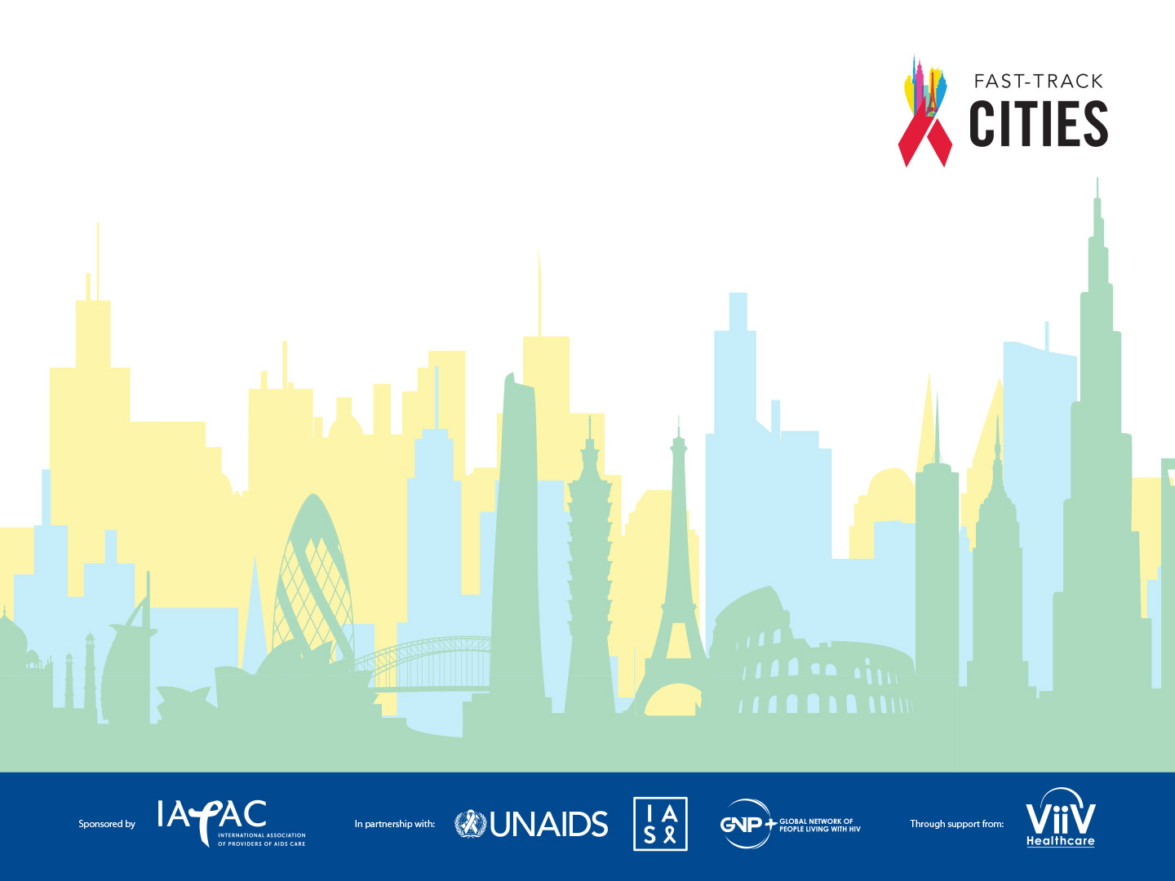
Eliminating Stigma & Discrimination in
Health Settings Delivering HIV Services
MODULE 1
HUMAN RIGHTS IN HEALTH SETTINGS
Notes:
Audio
Welcome to a three-module e-course focused on Eliminating Stigma and Discrimination in Health Settings Delivering HIV Services.
This e-course is sponsored by the International Association of Providers of AIDS Care, in partnership with the Joint United Nations Programme on HIV/AIDS, the International AIDS Society, and the Global Network of People living with HIV. We are grateful for support for this project from the US President’s Emergency Plan for AIDS Relief, and the US Agency for International Development.
Click on the right arrow for a description of the e-course and to begin Module 1.

Slide 2

GOALS OF THIS e-COURSE
Eliminating Stigma & Discrimination in
Health Settings Delivering HIV Services
01
To provide a simple, user-friendly, narrated, self-guided on-line resource for the training of health facilities and facility staff
02
To draw on existing field-tested & validated anti-stigma resources
Notes:
Audio
Irrational fears about AIDS and negative attitudes and judgments towards people living with and at-risk for HIV persist more than three decades into the HIV epidemic. The consequences of stigma and discrimination are wide-ranging and have significant negative impacts on the overall HIV response globally. Stigma and discrimination perpetrated in health settings, beyond representing human rights violations, also present barriers to accessing and utilizing medical and psychosocial support services that are critical for favorable outcomes among HIV-positive patients.
The first goal of this e-course is to educate health care providers about and build their capacity to reduce stigma and discrimination in health settings and thus improve access and utilization of quality HIV services. The second goal is to offer a user-friendly, self-guided, online resource for the training of health facility staff, drawing upon existing field-tested and validated anti-stigma resources.

Slide 3






LEARNING OBJECTIVES
Eliminating Stigma & Discrimination in
Health Settings Delivering HIV Services
Define stigma & discrimination
Identify causes & consequences of stigma & discrimination
Describe what stigma & discrimination looks like in health facilities
Identify ways to reduce stigma & discrimination in health facilities
Describe in practical terms how health care providers can reduce stigma in their day-to-day work
Describe how a facility can develop, implement, enforce & monitor an anti-stigma code of conduct & action plan
Notes:
Audio
There are six learning objectives for this e-course. By the end of the e-course, you will be able to:
define stigma and discrimination,
identify the causes and consequences of stigma and discrimination,
describe what stigma and discrimination looks like in health facilities,
identify ways to eliminate stigma and discrimination in health facilities,
describe in practical terms how health care providers can avoid engaging in stigmatizing behavior or communication in their day to day work, and
describe how health facilities can develop, implement, enforce, and monitor an anti-stigma code of conduct for health professionals and action plan for health facilities.

Slide 4
MODULE 1 HUMAN RIGHTS IN HEALTH SETTINGS
Eliminating Stigma & Discrimination in
Health Settings Delivering HIV Services
Notes:
Audio
Let’s begin with Module One: Human Rights in Health Settings. The goal of this module is to provide, through a human rights lens, an overview of the need to eliminate stigma and discrimination in health settings.

Slide 5
Eliminating Stigma & Discrimination in
Health Settings Delivering HIV Services
DECLARATION OF GENEVA
Adopted by the General Assembly of the World Medical Association (WMA) in 1948
Declared the medical profession’s dedication to humanitarianism
Intended as an update of the Oath of Hippocrates
The Declaration of Geneva requires medical professionals make the following pledges, among others:
“The health of my patient will be my first consideration.”
“I will not permit considerations of religion, nationality, race, party politics, or social standing to intervene between my duty and my patient.”
Notes:
Audio
The right to health is enshrined in various human rights instruments that form a legal entitlement. Rounding out these documents is the Declaration of Geneva, which was adopted by the General Assembly of the World Medical Association in 1948. It declares the medical profession’s dedication to humanitarianism and was intended as an update of the Oath of Hippocrates. The Declaration requires medical professionals make the following pledges, among others:
1) “the health of my patient will be my first consideration”; and
2) “I will not permit considerations of religion, nationality, race, party politics or social standing to intervene between my duty and my patient.”

Slide 6
HUMAN RIGHTS AND HEALTH
Eliminating Stigma & Discrimination in
Health Settings Delivering HIV Services
Human rights violations are common in health settings
In many parts of the world
Limiting accessing to quality health services
Health care workers also face discrimination
From co-workers and employers
Work in environments where their rights, responsibilities & roles are not recognized
Some examples of human rights violations
Coercion of patients
Substandard quality of care
Breaches of confidentiality
Notes:
Audio
Despite legal instruments, oaths, and declarations, human rights violations regrettably occur in health settings in many parts of the world, limiting patient access to quality health services and, by extension disempowering and depriving people of their basic dignity and their right to health.
Notably, health care workers also face discrimination in their personal and professional lives, and may work in environments where their rights, responsibilities, and roles are not recognized or respected.
Some examples of human rights violations include coercion of patients to submit to health procedures, denial of or delivery of substandard care, and breaches of confidentiality and privacy. We will examine these further later in this e-course.

Slide 7
HIV, HUMAN RIGHTS, & HEALTH
Eliminating Stigma & Discrimination in
Health Settings Delivering HIV Services
People who experience stigma & discrimination are marginalized & made more vulnerable to HIV
People living with HIV are more vulnerable to stigma & discrimination
Myths & misinformation increase stigma surrounding HIV
One in eight people living with HIV is being denied access to health services because of stigma & discrimination
Adopting a human rights-based approach is critical to maximizing individual heath outcomes & achieving HIV epidemic control
Source: HIV Stigma and Discrimination, AVERT.
Notes:
Audio
Here, we see some examples and consequences of human rights violations in the context of HIV prevention, care, and treatment. People who experience stigma and discrimination are marginalized and made more vulnerable to HIV. People living with HIV are more vulnerable to stigma and discrimination. Myths and misinformation – pervasive more than three decades into the HIV epidemic – increase the stigma surrounding HIV. One in eight people living with HIV is being denied access to health services because of stigma and discrimination.
Adopting a human rights-based approach – an approach that respects the inalienable rights of all people to equality, respect, dignity, and health – is critical to maximizing individual patient health outcomes and, ultimately, to achieving HIV epidemic control. For that reason, the Joint United Nations Programme on HIV/AIDS, or UNAIDS, advocated and the world has embraced the goal of achieving HIV-related zero stigma and discrimination by 2030.

Slide 8
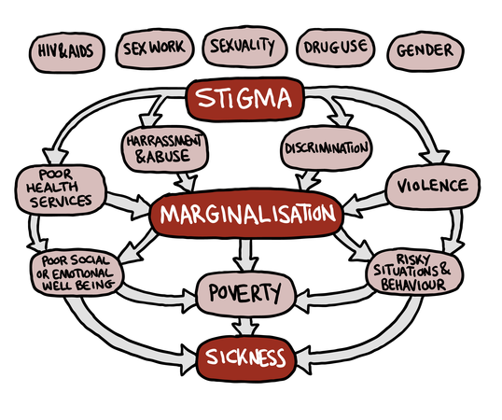
WHAT IS STIGMA?
Eliminating Stigma & Discrimination in
Health Settings Delivering HIV Services
“A social process of devaluing a person , beginning with marking or labeling someone’s differences, then attributing negative values to those differences”
Adapted from UNDP Stigma-Sickness Slope.
Notes:
Audio
Having a clear and precise definition for issues such as stigma and discrimination is important. Let’s start with stigma, which is defined as a social process of devaluing a person, beginning with marking or labeling someone’s differences, and attributing negative values to those differences. The graphic on the illustrates this process within the context of HIV/AIDS and populations vulnerable to HIV:
People who are stigmatized because they are living with HIV, because they engage in sex work or drug use, or express different gender norms fall victim to marginalization, becoming the subjects of harassment and abuse, discrimination, and violence. Within a health setting, they are also sometimes provided with poor quality health services. The results of marginalization can include poor social and emotional well-being, engaging in risky situations and behaviors, and in some instances, an exacerbation of economic circumstances, including poverty, all of which can result in poor health outcomes.

Slide 9
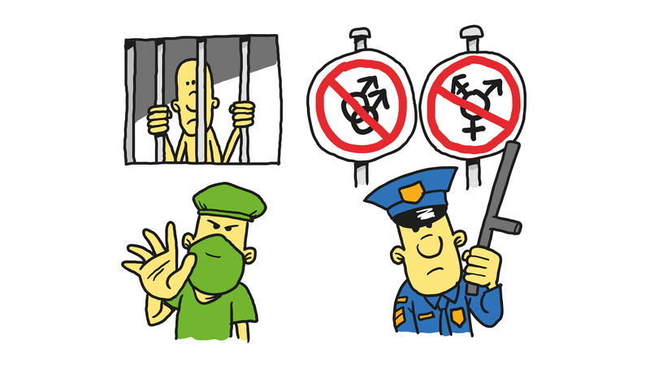
Eliminating Stigma & Discrimination in
Health Settings Delivering HIV Services
WHAT IS DISCRIMINATION?
“Unfair and unjust treatment of an individual on the basis of a real or perceived characteristic”
HIV status
Age
Race & ethnicity
Gender identity
Sexual orientation
Housing situation
Immigration status
Criminal record
Discrimination can be experienced at individual, facility, community, or national levels
National laws, policies & practices perpetuate discrimination in health care settings, prohibiting or discouraging people from seeking health care services they may need. – UNAIDS
Notes:
Audio
On to discrimination…
Discrimination is defined as the unfair and unjust treatment of individuals on the basis of a real or perceived characteristic such as HIV status, age, race and ethnicity, gender identity, sexual orientation, housing situation, immigration status, or criminal record. Because discrimination tends to be preceded by stigma, it is considered a form of enacted stigma.
Discrimination can be experienced at individual, facility, community, or national levels. At the national level, laws, policies and practices may perpetuate discrimination in health care settings, prohibiting or discouraging people from seeking the health services that they may need and to which they are entitled.

Slide 10

DISCRIMINATION
Eliminating Stigma & Discrimination in
Health Settings Delivering HIV Services
Discrimination affects both users of health care services & health care providers
Serves as a barrier to accessing health services & affects the quality of health services
Reinforces exclusion from society for both individuals & groups
Notes:
Audio
To be clear, discrimination affects both the users of health care services and health care providers. Discrimination serves as a barrier to accessing and utilizing health services, and it also affects the quality of those health services in ways that negatively impact health outcomes. Discrimination reinforces an exclusion from society for both individuals and groups of people, contributing to the isolation of any given individual or groups of individuals, that violates the rights to equality, dignity, and health.

Slide 11
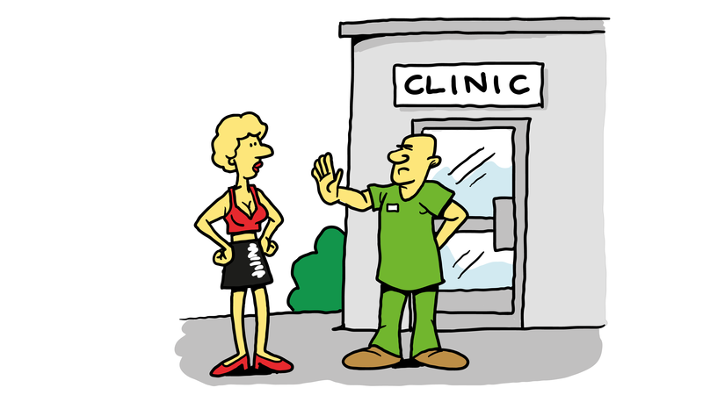
STIGMA DISCRIMINATION
Eliminating Stigma & Discrimination in
Health Settings Delivering HIV Services
Stigma is a belief or attitude
Discrimination is the action resulting from stigma
For example:
People living with HIV being refused treatment in a health facility
A patient’s HIV status or sexual identity being revealed publicly
Discrimination takes many forms
Denial of services
Physical or verbal abuse
Involuntary treatment
Forced contraception or abortion
As health workers, we sometimes automatically make judgments about people without realizing how these will affect them or the health services they receive
Source: Health Policy Project
Notes:
Audio
Stigma and discrimination are not mutually exclusive. They are intimately related. While stigma is a belief or attitude, the action resulting from stigma is discrimination.
For example, men who have sex with men, or MSM, may be denied access to all available HIV prevention options, including pre-exposure prophylaxis, or PrEP, because of “value-laden” judgments made by health workers based on personal values and beliefs. People living with HIV may be refused treatment in a health facility due to their HIV status or because they belong to a highly stigmatized key population such as people who inject drugs. A patient’s HIV status or sexual identity may be revealed publicly in egregious violation of the right to confidentiality.
Discrimination also takes the form of physical or verbal abuse, or involuntary or coercive treatment such as forced contraception or abortion. Stigma and discrimination may go unrecognized or unnoticed by health workers, who automatically make judgments about people without realizing how these judgements will affect the quality of the health services they deliver and could have a lasting negative impact on the health and well-being of their patients.

Slide 12

CYCLE OF IGNORANCE
Eliminating Stigma & Discrimination in
Health Settings Delivering HIV Services
Fear
Silence
Inaction
Stigma & Discrimination
Source: HIV/AIDS Stigma & Access to Care: National AIDS Minority Council and US Health Resources Services Administration (HRSA)
Notes:
Audio
To visualize these concepts, envision the cycle of ignorance. Stigma can be part of a virtuous, or vicious, cycle where fear, inaction, and silence lead to ongoing stigma and discrimination. Within a health setting delivering HIV services, stigma and discrimination are among many factors that contribute to disengagement from care and worse health outcomes in an era of potent HIV prevention and treatment options.

Slide 13
STIGMA & DISCRIMINATION IN REAL-LIFE
Eliminating Stigma & Discrimination in
Health Settings Delivering HIV Services
Notes:
Audio
Now that we have defined stigma and discrimination and the impact they have on access to and utilization of quality health services, let us take a moment to reflect on the real-life experiences of people living with HIV in relation to stigma and discrimination.

Slide 14
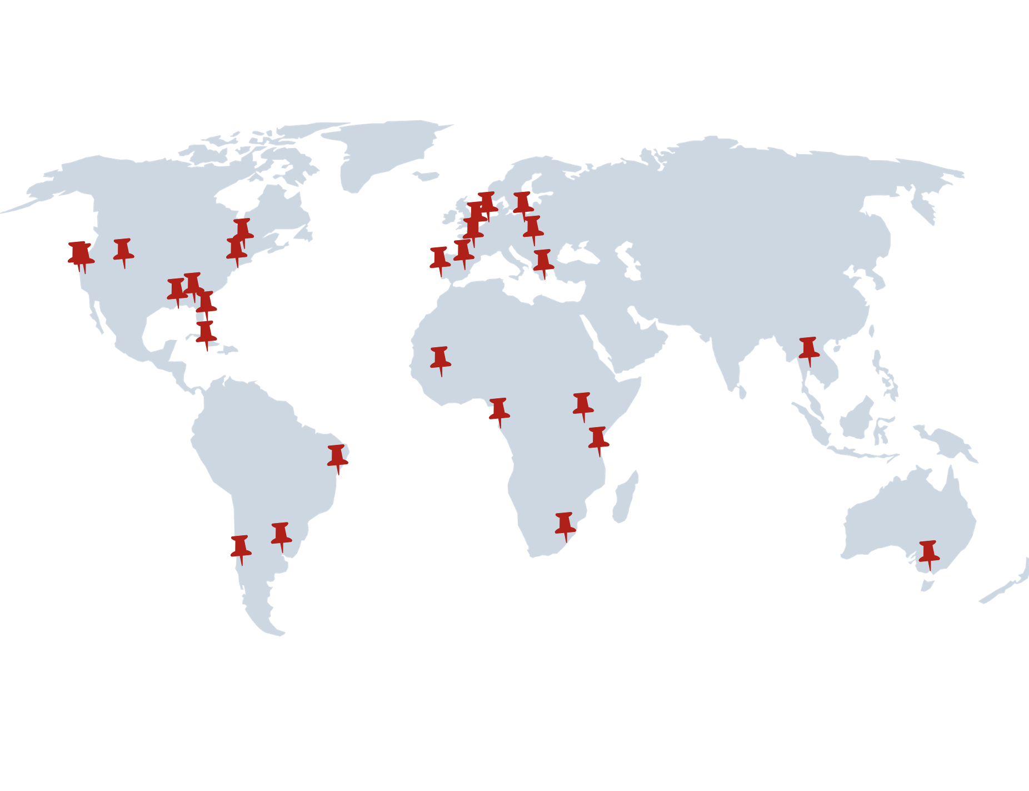
IAPAC QoL SURVEY
Eliminating Stigma & Discrimination in
Health Settings Delivering HIV Services
In 2018, IAPAC asked 1,380 people living with HIV in 29 Fast-Track Cities regarding their overall QoL
Survey included questions about:
Stigma in their communities
Stigma in health facilities
Amsterdam • Athens • Atlanta • Bamako • Bangkok • Berlin • Brussels • Bucharest Buenos Aires • Dar es Salaam
Denver • Durban • Geneva • Kingston • Lisbon • Libreville • Madrid • Melbourne • Miami • Montréal • Nairobi
New Orleans • New York City • Oakland Paris • Rio de Janeiro • Salvador de Bahia • San Francisco • Santiago
Notes:
Audio
Worldwide, more than 250 cities and municipalities around the world have formed a network of Fast-Track Cities committed to ending AIDS as a public health threat by 2030. In 2018, people living with HIV in 29 Fast-Track Cities around the world were surveyed to gauge, among other things, experienced stigma within their communities and in their health facilities. The 29 cities, representing a global distribution across every region of the world, are listed on the left-hand side of the screen.

Slide 15
IAPAC QoL SURVEY INTERIM RESULTS
Eliminating Stigma & Discrimination in
Health Settings Delivering HIV Services
63.4%
75%
31.3%
6.3%
19%
3.3%
Have you experienced stigma or discrimination in your healthcare facility in the past 12 months?
19% Said Yes
Have you experienced stigma or discrimination in your community in the past 12 months?
31% Said Yes
If yes, by whom?
75% Said By Health Worker
Notes:
Audio
Here, we see some interim results from the IAPAC quality of life survey.
In response to a question about whether they had experienced stigma or discrimination in their community in the past 12 months, almost one in three respondents said “yes.” When asked whether they experienced stigma or discrimination in their health facility in the past 12 months, almost 20% said “yes.” And, of those who said they had experienced stigmatization in their health facility, three-quarters, or 75%, of respondents said they were stigmatized by a health worker and almost 40% said they were stigmatized by health facility administration or personnel.
These preliminary findings are troubling but, regrettably, reflect the pervasive nature of stigma and discrimination almost four decades into the global HIV epidemic.

Slide 16
PUNITIVE PRACTICES, POLICIES & LAWS
Eliminating Stigma & Discrimination in
Health Settings Delivering HIV Services
In many countries and communities, policies and laws marginalize those most at risk of acquiring HIV infection
Laws may require health providers to report certain groups to law enforcement
Same-sex activity is outlawed in around 80 countries
Penalties ranging from jail sentences to execution
More than 100 countries criminalize some aspect of sex work & many outlaw it entirely
In many countries, transgender people are denied acknowledgement as “legal persons”
Harsh or illegal police practices force sex workers, LGBT people & people who use drugs to go underground & avoid health services
Migrants & refugees may be denied access to HIV prevention & treatment
People who use drugs may be detained in rehabilitation centers for many years
Systematic abuse of human rights
Forced labor
No treatment for drug dependence
Increased mortality
Notes:
Audio
In many countries, discriminatory, non-evidence-based laws serve to codify the marginalization of people most at risk of acquiring and those living with HIV. Laws may require health providers to report certain groups of people to law enforcement. Same-sex activity is outlawed in about 80 countries with penalties ranging from jail sentences to execution. More than 100 countries criminalize some aspect of sex work and may outlaw it entirely. In many countries, transgender people are denied acknowledgment as legal persons.
Harsh or illegal police practices force men who have sex with men and transgender individuals to avoid health services, driving local HIV epidemics underground and thus increasing HIV vulnerability. Migrants and refugees also may be denied access to HIV prevention and treatment. And, in some countries, people who use drugs may be detained in rehabilitation centers for many years with the systematic abuse of their human rights, forced labor, no treatment for their drug dependency and they may die in such centers.

Slide 17
HIV STIGMA TAKES MANY FORMS
Eliminating Stigma & Discrimination in
Health Settings Delivering HIV Services
Self-stigma
Negative self-judgement resulting in shame, worthlessness & isolation
Mental health issues (i.e., depression)
Mental heath generally is stigmatized
Often unrecognized & untreated in many settings
Societal stigma
Laws that criminalize the conduct of people living with HIV or exert punitive legal measures against HIV-vulnerable populations
Alienates people living with & at risk of HIV infection
Deters people from seeking HIV testing & treatment
Notes:
Audio
Given one in three respondents to the Fast-Track Cities Quality of Life survey reported experiencing stigma in their community, it is important to contextualize HIV-related stigma take many forms. Some examples are self-stigma and societal stigma.
Self-stigma entails a feeling of negative self-judgment, which can result in shame, worthlessness, and isolation, as well as contributes to failure to disclose one’s HIV status. It can also lead to mental health issues such as depression which is very common among people living with HIV. Notably, mental health itself is generally stigmatized and often unrecognized and untreated in many settings due to stigma.
Stigma at the societal level is caused by laws that criminalize the conduct of people living with HIV or exert punitive legal measures against HIV-vulnerable key populations, including men who have sex with men, transgender individuals, people who use drugs, and sex workers. This type of state-sanctioned stigma alienates people living with HIV and those at risk of acquiring HIV infection and deters people from seeking HIV testing and treatment, as well as harm reduction and other services.

Slide 18
HIV STIGMA TAKES MANY FORMS (CONTINUED)
Eliminating Stigma & Discrimination in
Health Settings Delivering HIV Services
Employment stigma
In the workplace, marginalized groups such as people living with HIV & migrants may be:
Stigmatized by co-workers & employers
Subject to termination or refusal of employment
Receive substandard pay
Household-level stigma
Can result in family rejection
May force people to leave their homes
Increases vulnerability, financial and housing insecurity & risk for transactional sex
Notes:
Audio
There are two additional forms of stigma that bear mentioning:
Employment stigma in the workplace marginalizes groups such as people living with HIV and migrants – HIV positive or negative. These individuals may be stigmatized by co-workers and employers, subject to termination or refusal of employment, or receive substandard pay.
Household-level stigma can result in family rejection, forcing people to leave their homes and increasing their vulnerability, financial and housing insecurity, and risk for engaging in transactional sex.

Slide 19
DRIVERS OF HIV-RELATED STIGMA
Eliminating Stigma & Discrimination in
Health Settings Delivering HIV Services
Lack of awareness
Health workers may be unaware that their attitudes, words & actions are stigmatizing
Moral judgement
Health workers may make negative judgments about people who are “different”
May not understand the lives, identities & sexuality of key populations vulnerable to HIV
MSM, transgender individuals, sex workers & PWUD may be seen as sinful or immoral, thus deserving of shame & blame
Fear & ignorance
Health workers may lack knowledge about & have misconceptions about HIV transmission & fear acquiring HIV through casual contact or medical procedures
Such fear & ignorance drives stigma
Notes:
Audio
There are three primary drivers of HIV-related stigma:
Lack of awareness among health workers is one driver. Health workers are often unaware that their attitudes, words, and actions are stigmatizing.
A second driver is the application of moral judgments. Health workers may make negative judgments about people who are “different” and may not understand the lives, identities, and sexuality of key populations vulnerable to HIV. People living with HIV, men who have sex with men, transgender individuals, sex workers, and people who use drugs may be viewed as sinful or immoral, thus deserving of shame, blame, and ill treatment.
Finally, health workers may lack knowledge about and have misconceptions about HIV transmission and therefore fear acquiring HIV through casual contact or medical procedures, such as drawing blood. Such non-evidence-based fear and ignorance drive stigma.

Slide 20
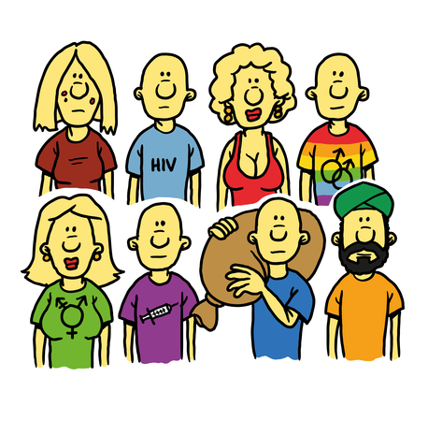
KEY POPULATIONS MOST AT RISK OF DENIAL OF CARE
Eliminating Stigma & Discrimination in
Health Settings Delivering HIV Services
Adolescents & young people
Particularly adolescent girls & young women
People living with HIV
Men who have sex with men
Transgender individuals
Sex workers
People who use drugs
Migrants & internally displaced persons
Ethnic minorities
Notes:
Audio
As noted previously, there are populations of people, known as key populations, who are the most at risk of being denied quality care. These populations include adolescents and young people, particularly adolescent girls and young women, people living with HIV, men who have sex with men, transgender individuals, sex workers, people who use drugs, migrants and internally displaced persons, and ethnic minorities.
Not surprisingly, members of these key populations are the most affected by HIV. Young women 15-24 years old in sub-Saharan Africa are twice as likely as young men to be living with HIV. Men who have sex with men are 19 times more likely to be living with HIV than the general population. HIV prevalence among sex workers is 12 times greater than among the general population. And, of the estimated 13.7 million people who use drugs worldwide, 13% are living with HIV.

Slide 21
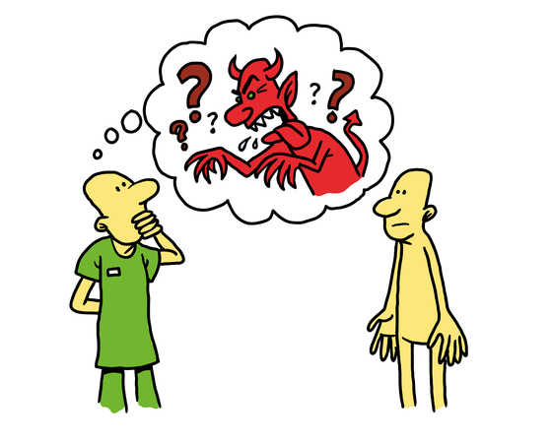
VALUES & BELIEFS
Eliminating Stigma & Discrimination in
Health Settings Delivering HIV Services
Our values & beliefs are the root cause of much stigma
Stem from our cultural and social upbringing
Learned behavior from our families, communities, & traditions
Affect the way we relate to other people
We may be unaware how these values & beliefs affect our behavior
What we learn as “normal” leads us to judge those who behave differently
Much stigma around HIV is related to values and beliefs about sex and morality
The following case study about Alejandro, an adolescent gay male, helps to illustrate
how our values and beliefs can drive stigma within a health facility setting.
Notes:
Audio
Where does stigma originate? Our values and beliefs are the root cause of much of the stigma perpetrated against people living with and at-risk for HIV. These values and beliefs stem from our cultural and social upbringing, and learned behavior from our families, communities, and traditions, all of which affect the way we relate to other people.
It is not uncommon that health professionals may be unaware how these values and beliefs affect their behavior. What we learn as quote-unquote “normal” behavior leads us to judge those who behave differently. Much of the stigma around HIV is related to our values and beliefs about sexuality and morality.
Let’s take a moment to look at an example of how this values and beliefs construct plays out in real-life by participating in a case study exercise. The case study revolves around Alejandro, a young gay latino, and serves to illustrate how values and beliefs can drive stigma within a health facility setting.

Slide 22

CASE STUDY
Eliminating Stigma & Discrimination in
Health Settings Delivering HIV Services
Values & Beliefs
Alejandro is 18 year old sexually active Latino gay male. He moved from his family home in a small town to study engineering in an urban faith-based college where he got a scholarship. He chats with other young people online and meets up for sex. Alejandro and his casual partners do not talk about HIV. He read about PrEP and thought it would be good option for him because he has not been consistently using condoms when he has sex. He spoke to his college campus doctor about starting PrEP. The doctor did not feel comfortable providing Alejandro with PrEP and referred Alejandro to his family physician. He never went because he knew his family doctor would ask Alejandro’s parents before providing him with Prep. He knows his parents will say no. Alejandro is still dating on-line and using condoms 80% of the time.
Adapted from the Health Policy Project
Notes:
Audio
This young man is at significant risk of acquiring HIV infection. We know this because he is having frequent casual sex with people who's HIV status he does not know and is not using condoms consistently. He is also read about and expressed interest in taking PrEP and this, in itself ,means that he is at risk, at least in his own mind. There are no contraindications to Alejandro receiving PrEP but he is being denied access to care because of real or perceived values and beliefs of healthcare providers.
Developer’s Notes

Slide 23
LEARNING FROM ALEJANDRO’S CASE
Eliminating Stigma & Discrimination in
Health Settings Delivering HIV Services
Young sexually active gay men at significant risk for acquiring HIV infection have a human right to PrEP
Much stigma is related to issues surrounding morality, sex, religion and youth
The personal beliefs of the college doctor prevented Alejandro from accessing the care that he needs
The college doctor is providing substandard of care
No mechanism for Alejandro to speak out
In this college environment
Alejandro’s perception that he will be denied access from his family doctor
Second block in his attempt to access to what he needs and deserves as a right to health
The college doctor should have provided the care he needed
Adapted from www.avac.org
Notes:
Audio
What can we learn from Alejandro’s case?
For whatever reason, his primary point of medical care, the college campus physician, is reticent to provide Alessandro with PrEP. The reticence is neither in the best interest of Alejandro’s health and wellbeing nor acceptable from a health care provider. Further, the college doctor has provided the patient with an option which is not going to achieve goal of getting him the care the he needs. All of us entrusted with providing the best care to everybody must put aside our beliefs and values and considered only the well-being of patients we care for, especially the young and vulnerable.
Developer’s Notes
Graphics
References

Slide 24

WHAT CAN WE LEARN FROM ALEJANDRO’S CASE?
Eliminating Stigma & Discrimination in
Health Settings Delivering HIV Services
Personal beliefs related to
The culture of the health setting
Traditional Family values
Young people and sexuality
The right of people to choose how to protect themselves
Are significant barriers to quality care
Health care workers must be educated
Realize how these personal values may lead to stigma
Notes:
Audio
Young people have the right to make choices and access the care that meets the needs. Unfortunately, the values and beliefs of care providers and family may be barriers to this choice and access. It is essential that education be provided to healthcare workers to ensure that they realize how their personal values can, sometimes inadvertently, lead to stigma and the provision advice and care to vulnerable and people which is inappropriate and substandard and puts young people at even more risk.

Slide 25
EFFECTS OF STIGMA ON KEY POPULATIONS
Eliminating Stigma & Discrimination in
Health Settings Delivering HIV Services
Feelings of shame & self-doubt
Anxiety & depression
Excessive alcohol & drug use
Changing to another health facility, private doctors or self-treatment
Delayed HIV treatment initiation
HIV treatment interruption or stopping treatment altogether
Non-disclosing & taking more risks such as condom-less sex & not using clean needles
Hiding sexual orientation, drug use, or sex work
The following case study of Dakota, a transgender woman, illustrates the consequences of stigma in health settings
Notes:
Audio
We talked earlier about key populations most at risk of denial of care earlier. The effects of stigma on key populations include feelings of shame and self-doubt, anxiety and depression, not disclosing HIV status to others, excessive alcohol and drug use, delayed initiation of HIV treatment, and treatment interruption or stopping treatment all together.
Studies on stigma and discrimination and health-seeking behavior show that people living with HIV who perceive high levels of HIV-related stigma are 2.4 times more likely to delay enrollment in care until they are very ill. Stigma may also increase risk-taking, including condom-less sex or not using clean needles, as well as hiding ones sexual orientation, drug use, or sex work from health providers.
Let’s explore the following case study involving Dakota, a transgender woman, illustrates the consequences of stigma against key vulnerable populations in health settings

Slide 26
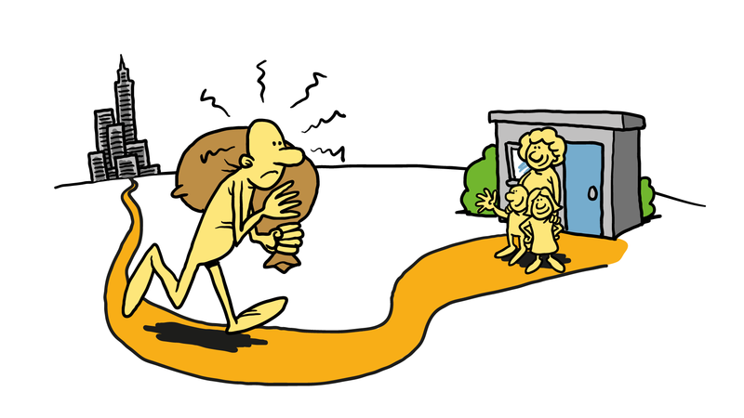
CASE STUDY
Eliminating Stigma & Discrimination in
Health Settings Delivering HIV Services
Disclosure
Dakota is transgender woman aged 21, living with her cousin. She knows that her cousin does not approve of the lifestyle but puts up with her because she is family. For the past 5 years, she has been supporting herself with casual work in a local bar where she meets men and offers them sex for payment to supplement her meagre income from the bar. She likes to take amphetamines before sex and this takes up her quite a bit of her available money. She takes amphetamines most days. She has one regular client pays her double every week not to use a condom. One night, the bar was offering free HIV testing and she took a test which was positive. She went to a nearby clinic but the staff were very unfriendly to her. She was given antiretroviral therapy but no one examined her, asked her about her drug use or sex work and she was not counseled about disclosing her HIV status to her sexual partners or family. She never went back to the clinic and when her antiretrovirals ran out, she stopped. She continued to have unprotected sex with clients. A year later, she was admitted to the emergency room with dehydration, following a month of persistent diarrhea. She was diagnosed with cryptosporidiosis and AIDS.
Notes:
Audio
Dakota is transgender woman aged 21, living with her cousin. She knows that her cousin does not approve of the lifestyle but puts up with her because she is family. For the past 5 years, she has been supporting herself with casual work in a local bar where she meets men and offers them sex for payment to supplement her meagre income from the bar. She likes to take amphetamines before sex and this also eats up her quite a bit of her available money. She takes amphetamines most days. She has one regular client pays her double every week not to use a condom. One night, the bar was offering free HIV testing and she took a test which was positive. She went to a nearby clinic but the staff were very unfriendly to her. She was given antiretroviral therapy but no one examined her, asked her about her drug use or sex work and she was not counseled about disclosing her HIV status to her sexual partners or family. She never went back to the clinic and when her antiretrovirals ran out, she stopped. She continued to have unprotected sex with clients. A year later, she was admitted to the emergency room with dehydration, following a month of persistent diarrhea. She was diagnosed with cryptosporidiosis and AIDS.

Slide 27
Eliminating Stigma & Discrimination in
Health Settings Delivering HIV Services
Stigma in heath care settings stops vulnerable PLHIV from…
Accessing quality health services
Engaging in continuous care and disclosing their status
Addressing other health issues such as substance use
People often experience multiple
(or layered) stigma
Dakota
Did not disclose her status fearing family rejection
Was lost to follow up after her first visit
Continued to expose others to risk
Finally presented to care with advanced HIV disease
LEARNING FROM DAKOTA’S CASE
Notes:
Audio
What lessons can we learn from Dakota’s case?
Stigma in health care settings prevents people vulnerable people living with HIV, especially transgender people like Dakota, from accessing quality care, being retained in care and disclosing their HIV status to their partners, families, and friends. It affects people’s willingness to protect their own health and the health of their partners and stops them from accessing health services. People like Dakota often experience multiple, or layered, stigma. Transgender people may be stigmatized by their appearance, lifestyle and substance use. In this case, the consequences were catastrophic resulting in Dakota finally re-presenting into care with advance advanced HIV disease.
Developer’s Notes
Graphics
References

Slide 28
WHAT CAN WE LEARN FROM DAKOTA’S CASE?
Eliminating Stigma & Discrimination in
Health Settings Delivering HIV Services
Dakota’s physician should have:
Taken a thorough medical history
Including her drug use and its possible effect on her adherence
Advised Dakota about the importance of disclosing her HIV status to intimate partners & the need for a social support network
Developed a plan to ensure active follow up
after initiation of antiretroviral therapy
Referred Dakota to drug counselling services
Notes:
Audio
What could have been done differently in Dakota’s case? At the first contact with her, the physician should have treated Dakota like everyone else with respect and dignity and not unfriendliness and a cursory medical history and no exanimation. She should have had her drug use addressed through counseling and plan put in place for active follow up given that she was at risk of poor adherence and defaulting. Dakota should have been counseled comprehensively about the importance of safe sex and the need for a social support network.

Slide 29
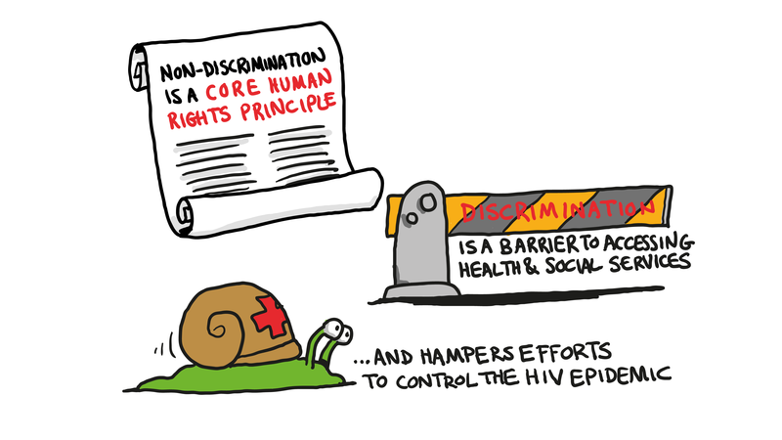
AGENDA FOR ZERO STIGMA IN HEALTH SETTINGS
Eliminating Stigma & Discrimination in
Health Settings Delivering HIV Services
Zero stigma & non-discrimination are core human rights principles & obligation, but within health care settings they remain widespread & take many forms
Stigma & discrimination are barriers to accessing health & community services & prevents the attainment of universal health coverage
Stigma & discrimination lead to poor health outcomes and hampers efforts to achieve healthy lives for all and control of the HIV epidemic
Notes:
Audio
The Joint United Nations Program on HIV and AIDS, or UNAIDS, has affirmed that stigma and discrimination represent violations of core human rights principals and obligations. Thankfully, most health workers do not engage in stigmatizing and discriminatory behaviors, yet stigma and discrimination in health settings is still all too common and they take many forms as illustrated in this module’s two case studies.
Stigma and discrimination are unacceptable barriers to accessing and utilizing HIV and other health services and thus prevent the attainment of universal health coverage and, ultimately, the realization of the right to health. Finally, stigma and discrimination lead to poor health outcomes and hampers efforts to achieve healthy lives for all people living with and affected by HIV. and control of the HIV epidemic.

Slide 30
SUMMARY OF KEY ANTI-STIGMA & ANTI-DISCRIMINATION PRINCIPLES
Eliminating Stigma & Discrimination in
Health Settings Delivering HIV Services
Accessible & high quality services for everyone
Non-discrimination & equality
Privacy & confidentiality
Respect for personal dignity & autonomy
Meaningful participation of patients in their care
Accountability by addressing stigma & discrimination at all levels
Notes:
Audio
In the next module of this e-course, we will examine how you can integrate stigma reduction into your daily practice. To finish this module, though, we end with a summary of key anti-stigma and anti-discrimination principles. Health workers should deliver accessible and high-quality services to all people based on the principles of non-discrimination and equality. Privacy and confidentiality must be guaranteed, and respect shown for personal dignity and autonomy. The meaningful participation of people living with and affected by HIV in their own care is critical. And professional accountability must be demonstrated by addressing and eliminating stigma and discrimination at all levels.

Slide 31
REFLECTION POINTS
Eliminating Stigma & Discrimination in
Health Settings Delivering HIV Services
Let’s reflect upon the content from Module 1:
What is the link between health and human rights?
How does stigma & enacted stigma (discrimination) violate the human right to health? Act as a barrier to accessing & utilizing HIV services?
What is your obligation as a health workers in delivering stigma-free care, treatment & support services to people living with HIV?
How will you integrate what you have learned in this module into your daily HIV clinical practice?
Notes:
Audio
We have covered a lot of ground in Module 1 of this three module e-course entitled, Eliminating Stigma and Discrimination in Health Settings Delivering HIV Services.
Let’s reflect upon the content shared in this module from your personal and professional perspectives. Take a few minutes to ponder the following questions:
What is the link between health and human rights? How does stigma and enacted stigma (discrimination) violate the human right to health? What is your obligation as a health worker in delivering stigma-free care, treatment, and support to people living with HIV? How will you integrate what you have learned in Module 1 into your daily HIV clinical practice?

Slide 32
ACKNOWLEDGEMENTS
Eliminating Stigma & Discrimination in
Health Settings Delivering HIV Services
IAPAC acknowledges the contributions made by the following institutions towards the development of this e-course:
Joint United Nations Programme on HIV/AIDS (UNAIDS), International AIDS Society (IAS), Global Network of People living with HIV (GNP+), Association of Nurses in AIDS Care (ANAC) & International Treatment Preparedness Coalition (ITPC)
Funding for this project was made possible through the support of ViiV Healthcare.
Notes:
Audio
IAPAC wishes to acknowledge contribution made by our partner institutions in the development of this e-course. Our thanks to the Joint United Nations Programme on HIV/AIDS, the International AIDS Society, the Global Network of People living with HIV, the Association of Nurses in AIDS Care, and the International Treatment Preparedness Coalition.
We also acknowledge that funding for this project was made possible through the support of ViiV Healthcare.

