Slide 1
Eliminating Stigma & Discrimination in
Health Settings Delivering HIV Services
MODULE 3
Resources for Health Facility Administrators
Notes:
Audio
Welcome to module 3 of this e-course entitled, Eliminating Stigma and Discrimination in Health Settings Delivering HIV Services. In the first and second modules, we defined what stigma and discrimination mean, identified their causes and consequences, and reviewed some strategies for eliminating them within health settings and examined what stigma looks like in the context of a health facility. The goal of this third module is to provide practical advice for clinic administrators and managers on how to measure stigma and discrimination in the health facility and to devise, implement and monitor a code of conduct and an action plan to address stigmatizing practices.
Developer’s Notes
Graphics
References

Slide 2
actionable causes of stigma & discrimination
Actionable Causes:
Ignorance about the harm of stigma
Irrational fears of acquiring HIV infection
Moral judgement
Approaches to reducing stigma & discrimination:
Measurement of stigma in health care settings
Peer mobilization developed for and by PLHIV
Engagement with religious & community leaders
Inclusion of non-discrimination in workplace policies
Source: Key Programs to Reduce Stigma and Discrimination and Increase Access to Justice in National HIV Responses; Guidance Note UNAIDS 2012
Notes:
Audio
There are three main actionable causes of stigma and discrimination. These are ignorance about the harm of stigma, irrational fears of acquiring HIV infection and moral judgment. UNAIDS advises that key approaches to reducing stigma and discrimination include the measurement of stigma in health settings, peer mobilization developed for and by people living with HIV, engagement with religious and community leaders and celebrities, and the inclusion of nondiscrimination in workplace policies.
Developer’s Notes
Graphics
References

Slide 3
Training for health care providers
Human rights & anti-stigma training for health care providers should focus on two objectives:
Ensure that health care providers know about the human right to health for their patients and themselves:
Right to dignity, respect & confidentiality
Right to HIV prevention & treatment
Right to universal precautions
Reduce stigmatizing attitudes in health care settings:
Provide health care workers with the skills & tools necessary to eliminate stigma
Ensure each patient’s right to informed consent, confidentiality, quality treatment & non-discrimination
Source: Key Programs to Reduce Stigma and Discrimination and Increase Access to Justice in National HIV Responses; Guidance Note UNAIDS 2012
Notes:
Audio
UNAIDS further advises that training for healthcare providers in human rights and ethics should focus on two objectives. One is to ensure that healthcare providers know about their own human rights to health including HIV prevention and treatment for themselves, universal precautions at work, and compensation for work-related infection. Second is the reduction of stigmatizing attitudes in health settings by providing healthcare workers with the skills and tools necessary to ensure that clients’ rights to informed consent, confidentiality quality treatment and nondiscrimination are enforced.
Developer’s Notes
Graphics
References

Slide 4
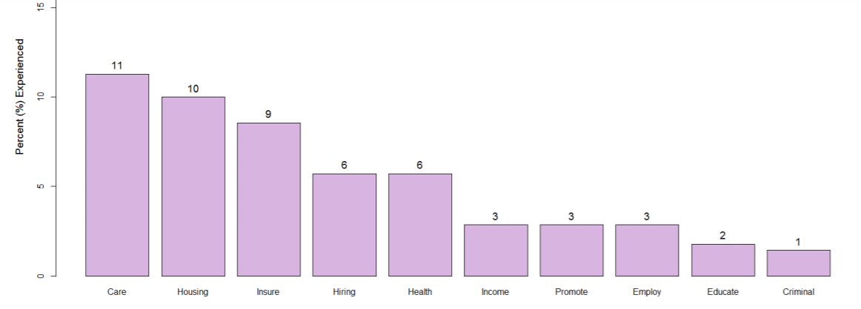
Denied health services because of HIV status in Michigan
Source: The U.S. People Living with HIV Stigma Index Michigan|2016
Notes:
Audio
Before we move on to measuring stigma in health facilities and measures to mitigate stigma, let's take a look at two examples of health stigma and discrimination in the United States. This survey conducted as part of the U.S. People Living with HIV Stigma Index in Michigan in 2016 revealed that most common manifestation of stigma and discrimination was denial of healthcare services. This was closely followed by discrimination in housing, health insurance and employment.
Developer’s Notes
Graphics
References

Slide 5
Finding Respect and Ending Stigma around HIV (FRESH) Workshop in ALABAMA
Online surveys of health care staff
Conducted in Alabama and Mississippi
Assess perceptions of HIV-related stigma
Among staff in public health and primary care
89–93% of survey respondents
Endorsed at least one stigmatizing attitude
Adaptation and Implementation of an Intervention to Reduce HIV-Related Stigma Among Healthcare Workers in the United States: Piloting of the FRESH Workshop D. Scott Batey, PhD, Samantha Whitfield, MPH, Mazheruddin Mulla, MA, Kristi L. Stringer, MA, Modupeoluwa Durojaiye, MA, Lisa McCormick, DrPH, Bulent Turan, PhD, Laura Nyblade, PhD, Mirjam-Colette Kempf, PhD, and Janet M. Turan, PhD AIDS PATIENT CARE and STDs Volume 30, Number 11, 2016
Notes:
Audio
To pilot FRESH workshops in Alabama sought to assess the feasibility and acceptability of the healthcare setting stigma reduction intervention. The workshop interventions were sharing of information, increasing contact and interaction between health workers and people living with HIV, and utilizing empowerment strategies to improve coping with HIV-related stigma. The workshops covered an overview of HIV-related stigma, intersectional stigma, knowledge update on HIV transmission, prevention, and treatment, coping with stigma and addressing stigma through stigma-reduction strategies and tools.
As part of the workshops, two surveys were conducted. One was an online survey of healthcare staff in Alabama and Mississippi assessing perceptions of HIV related stigma among staff in public health and primary care facilities. Around 90% of survey participants endorsed at least one stigmatizing attitude.
Developer’s Note
Graphics
References

Slide 6
Finding Respect and Ending Stigma around HIV (FRESH) Workshop in ALABAMA
Questionnaire completed by PLWH
University-based HIV primary care clinic in Alabama
People continue to experience stigma in healthcare facilities
Manifested by…
denial of care
Receiving poor quality of care
Disclosure
Adaptation and Implementation of an Intervention to Reduce HIV-Related Stigma Among Healthcare Workers in the United States: Piloting of the FRESH Workshop D. Scott Batey, PhD, Samantha Whitfield, MPH, Mazheruddin Mulla, MA, Kristi L. Stringer, MA, Modupeoluwa Durojaiye, MA, Lisa McCormick, DrPH, Bulent Turan, PhD, Laura Nyblade, PhD, Mirjam-Colette Kempf, PhD, and Janet M. Turan, PhD AIDS PATIENT CARE and STDs Volume 30, Number 11, 2016
Notes:
Audio
The second was a questionnaire completed by people living with HIV and the University based HIV primary care clinic in Alabama. This survey showed that people continue to experience stigma in healthcare for facilities particularly manifested by denial of care, receiving poor quality of care and disclosure of their HIV status without their knowledge
Developer’s Notes
Graphics
References

Slide 7
Measuring stigma
IAPAC’s Guidelines for Optimizing the HIV Care Continuum for Adults and Adolescents recommend:
“Strategies to monitor for and eliminate stigma and discrimination based on race, ethnicity, gender, age, sexual orientation, and/or behavior in all settings, but particularly in health care settings, using standardized stigma measures and evidence-based approaches.”
IAPAC Guidelines for Optimizing the HIV Care Continuum for Adults and Adolescents, International Advisory Panel on HIV Care Continuum Optimization (2015)
Notes:
Audio
The next few slides deal with measuring stigma health facilities. The IAPAC Guidelines for Optimizing the HIV Care Continuum for recommend: “Strategies be put in place to monitor for and eliminate stigma and discrimination based on race, ethnicity, gender, age, sexual orientation or behavior in all settings, but particularly in healthcare settings, using standardized stigma measures and evidence-based approaches.” Several tools for measuring stigma are available.
Developer’s Notes
Graphics
References

Slide 8
People Living with HIV Stigma Index
A tool that measures and detects changing trends in stigma & discrimination experienced by PLHIV
More than 90 countries have completed the index
More than 2,000 PLHIV have been trained as interviewers
Over 100,000 PLHIV have been interviewed
Questionnaire has been translated into 54 languages
Notes:
Audio
The People Living with HIV Stigma Index is a tool that measures and detects changing trends in stigma and discrimination experienced by people living with HIV. It has been used more than 90 countries, more than 2,000 people living with HIV have been trained as interviewers and 100,000 PLHIV have been interviewed. The PLHIV stigma index questionnaire has been translated into 54 languages.
Developer’s Notes
Graphics
References

Slide 9
MEASURING FACILITY-LEVEL STIGMA
‘It Starts with Us’ is a health facility intervention developed by IAPAC:
Includes a facility-level checklist that assesses whether the following are in place:
Equal access to care
Confidentiality policy/practice
Access to safety & infection control
Training for health care providers & staff
Policies to address/redress violations
Continuous quality assurance
Notes:
Audio
A facility level checklist developed by IAPAC assesses whether the following are in place at the facility. Equal access to care, confidentiality, safety and infection control, training, policies, quality assurance.
Developer’s Notes
Graphics
References

Slide 10
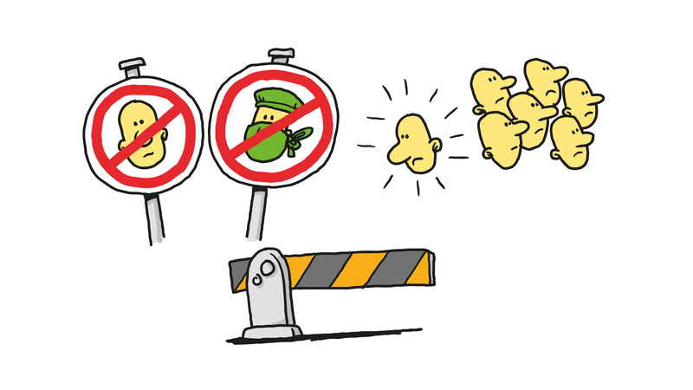
It STARTS WITH US FACILITY-LEVEL checklist
EQUAL ACCESS TO CARE
□ Access to care and support is not delayed or denied regardless of HIV status, gender, sexual orientation, key population characteristics | □ All HIV tests are voluntary □ Services for PLHIV are integrated into other facility departments to protect privacy
CONFIDENTIALITY
□ Client information and HIV status is communicated only to the client and treating staff unless informed consent is obtained from the client | □ Client records are stored in a secure place □ Client files not labelled in a way that indicates HIV status
SAFETY/INFECTION CONTROL
□ Standard, universal precaution measures are practiced equally among patients | Supplies essential to staff safety and infection control is readily available to all staff Proper waste management procedures are in place
TRAINING
□ Staff are trained in the rights of PLHIV and other vulnerable populations to equal quality care | □ Staff are trained on clients’ rights to privacy and confidentiality
□ Staff are trained in HIV and other infection disease transmission and universal precautions | Staff are trained to eliminate stigma and discrimination in the facility Staff are trained in testing and counselling procedures
POLICIES
□ Facility has a policy, visible to both healthcare workers and clients, on stigma & discrimination, equal access to care, voluntary testing, confidentiality, safety and infection control | □ Facility has a policy, visible to both healthcare workers and patients, on responding to client complaints as they relate to stigma and discrimination
QUALITY ASSURANCE
□ A team is in place to monitor and ensure all staff respect policies and procedures related to equal access to care, voluntary testing, confidentiality safety and infection control | □ A team and protocol is in place to prevent and address violations to policies and procedures □ The facility makes it easy for clients to register grievances and complaints
Notes:
Audio
Under equal access to care, the checklist assess whether access to care and support is not delayed or denied regardless of HIV status, gender, sexual orientation, key population characteristics, if HIV tests are voluntary and if services for PLHIV are integrated into other facility departments to protect privacy.
Under confidentiality, the checklist assesses whether client information and HIV status is communicated only to the client and treating staff unless informed consent is obtained, whether records are stored in a secure place and if files are not labelled in a way that indicates HIV status.
Are standard, universal precaution measures practiced equally among patients and are supplies essential to staff safety and infection control readily available to all staff?
Are staff are trained in the rights of PLHIV and other vulnerable populations to equal quality, privacy and confidentiality infection transmission and universal precautions, and the elimination of stigma and discrimination in the facility?
Are policies in place on stigma & discrimination, equal access to care, voluntary testing, confidentiality, safety and infection control and are policies in place for responding to client complaints?
Finally for quality assurance, is a team is in place to monitor and ensure all staff respect policies and procedures related to equal access to care, voluntary testing, confidentiality safety and infection control and address violations and does the facility makes it easy for clients to register grievances and complaints?
Developer’s Notes
Graphics
References

Slide 11
What is a stigma-free health facility
A stigma-free health facility is one in which:
PLHIV & other key populations are treated with respect & compassion & provided with high-quality care
PLHIV & other key populations are treated the same as everyone else coming to the facility
There are open, safe & consequence-free means of communicating violations of human rights in the facility to facility management
Health facility staff are able to protect themselves from HIV transmission in the workplace through the use of universal precautions
Health facility staff feel confident about getting tested for HIV, living with HIV & continuing to work
Adapted from the Health Policy Project
Notes:
Audio
So, what is a stigma free facility? It is one in which people living with HIV and other key populations are treated with respect and compassion and provided with high quality care. People living with HIV and other key populations are treated the same as everyone else coming to the facility. There are open safe and consequence-free means of communicating violations of human rights to facility management. Health facility staff are able to protect themselves from HIV transmission in the workplace through the use of standard precautions. The facility staff feel confident about getting tested for HIV, living with HIV and continuing to work in the facility.
Developer’s Notes
Graphics
References

Slide 12
How to make your facility stigma free
1. Set up a Stigma Working Group
Include managers, clinical staff, nonclinical staff & patients
Make the Stigma Working Group responsible for developing, implementing & monitoring stigma-related activities in the facility
2. Assess your facility
IAPAC’s Stigma Dialogue Navigator for Clinicians provides an assessment Checklist for a Stigma-Free Facility Environment and Policies
IAPAC’s It’s Up to Us facility-level checklist regarding equal access to care, confidentiality, safety/infection control, training, policies & quality assurance
3. Review current policies & practices with facility staff & patients
4. Obtain input & buy-in from community organizations representing key populations
Notes:
Audio
What are the steps in making your facility stigma free? One, set up a stigma working group which includes managers, clinic staff, nonclinical staff and clients. This group will be responsible for developing and implementing stigma related activities in the facility and monitoring progress. Two, assess your facility. Health policy project guide for administrators provides an assessment checklist for stigma free facility environment and policies. Three, review current policies and practices with facility staff and clients. Four, obtain input and buy-in from local community organizations and key populations.
Developer’s Notes
Program the on-screen text, “Checklist for Stigma-free Facility Environment and Policies” so that it is a hyperlink to the following PDF: http://www.iapac.org/files/2018/07/Caliber_of_Care-IAPAClo.pdf
Graphics
References

Slide 13
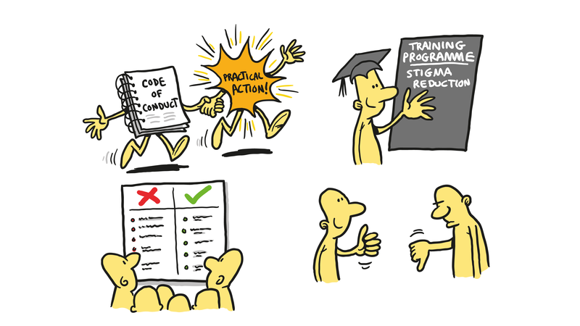
How to make your facility stigma free (continued)
5. Develop & launch a Code of Conduct with agreed principles governing behaviors in areas such as patient rights, maintaining confidentiality & delivering quality care
6. Create an Action Plan to implement the Code of Conduct & anti-stigma policies
7. Continuously monitor progress
Conduct an annual assessment
Discuss progress & challenges with staff & patients
Notes:
Audio
Five, develop and launch a code of conduct of agreed principles and behaviors in areas such as patient confidentiality, patient rights, respect and quality of care. Six, create an action plan to disseminate and implement a code of conduct. Seven, monitor progress and discuss progress and challenges with staff.
Developer’s Notes
Graphics
References

Slide 14
Global Code of conduct
Produced by the IAS, in partnership with IAPAC, UNAIDS, and others
Promotes a human rights-based approach to health care service delivery for HIV & health professionals via nine guiding principles:
Know your Human Rights Responsibilities
Respect Dignity
Benefit from Scientific Progress
Access to Justice
Know your Epidemic, Know your Response
Meaningful Participation
Education
Monitoring and Evaluation
Accountability
Notes:
Audio The International AIDS Society and partners have produced a code of conduct based on a human rights approach to every aspect of HIV prevention testing care and support for people living with HIV, key populations and all those affected HIV
Developer’s Notes
Graphics
References

Slide 15
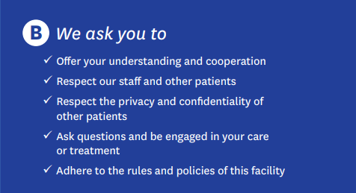
A National code of Conduct
Developed in St. Kitts & Nevis & adopted by all government health facilities in the country
By signing & adopting the Code of Conduct, staff commit to eliminate stigma, prevent human rights violations & provide the best quality care possible
Development of the Code of Conduct was supported by USAID & PEPFAR-funded Health Policy Project
Notes:
Audio
Take a moment to look at this code of conduct developed in St. Kitts and Nevis in the Caribbean. It has been adopted by all government health facilities in the country. Development of the code was supported by the USAID and PEPFAR funded Health Policy Project. The code of conduct consists of part A and part B. In Part A, staff commit to eliminating stigma, preventing human rights violations and providing the best quality care possible. Part B code asks clients to offer understanding and cooperation, respect for staff and patients, respect for privacy and confidentiality of other patients, to ask questions and be engaged in their care and adhere to the rules and policies of this facility.
Developer’s Notes
Graphics
References

Slide 16
DISSEMINATING THE CODE OF CONDUCT
Post the Code of Conduct throughout the facility
Present & discuss the Code of Conduct during staff meetings
Announce the Code of Conduct through social media
Share the Code of Conduct with community groups, notably those working with key populations
Plan an event & press release to officially launch the Code of Conduct (invite staff, community members & media to attend the launch)
Notes:
Audio
The next step is to disseminate the Code of Conduct. Post the code throughout the facility, present and discuss for the Code at staff meetings, announce the code through social media, share the code with community groups and organizations including those who work with key populations and, finally plan an event and press release to launch the code officially and invite staff community members and media to attend.
Developer’s Notes
Graphics
References

Slide 17
Action Plan
The Code of Conduct should be linked to practical action
Incorporate stigma reduction into existing training programs for staff
Provide clear guidance to staff on what is acceptable & what is unacceptable in the new work environment
Provide guidance to supervisors on how to respond to non-stigmatizing vs stigmatizing behavior from staff members
Notes:
Audio
The code of conduct must be linked to an action plan. Incorporate stigma reduction into existing training programs for staff. Provide clear guidance to staff on what is acceptable and what is unacceptable in the new work environment. Provide guidance to supervisors on how to respond to good and to stigmatizing behavior from staff members.
Developer’s Notes
Graphics
References

Slide 18
Action Plan (continued)
Support staff to talk with patients about stigma
Empower patients to speak out if they feel stigmatized or discriminated, or if they witness stigma or discrimination by anyone in the facility
Get feedback from clients about experiences in the facility
Design & implement a patient questionnaire
Analyze responses & ensure staff see what patients are saying about their care
Take corrective action
Notes:
Audio
More about the action plan. Support staff to talk with clients about stigma and empower clients to speak out if they feel stigmatized or discriminated or they witness stigma and discrimination by anyone in the facility. Get feedback from clients about their experiences in the facility. Design and implement a client questionnaire, analyze responses, ensure staff see what clients are saying about the care and take corrective action.
Developer’s Notes
Graphics
References

Slide 19
In Summary
Understand
Understand how stigma & discrimination affect quality of care
Accept
Accept that stigma & discrimination are unacceptable in health settings
Plan
Make a plan starting with the establishment of an all-inclusive anti-Stigma Working Group
Assess
Assess stigma in your facility using one of the available tools OR develop you own questionnaire relevant to your facility (but keep it simple & practical)
Develop, implement & enforce
Develop, implement & enforce a Code of Conduct
Train
Train & re-train staff
Embed
Embed an anti-stigma culture into every aspect of day-to-day facility life
Advertise the Code of Conduct in the facility
Notes:
Audio
This is slide summarizes key learning points in this module under the headings of understand, accept, plan, assess, develop implement and enforce, train and embed. Understand how stigma and discrimination affect quality of care. Accept that stigma and discrimination are unacceptable in health settings. Make a plan starting with the establishment of an all-inclusive anti-stigma working group. Assess stigma in your facility using one of the available tools or develop your own questionnaire relevant to your facility but keep it simple and practical. Develop, implement and enforce a simple code of conduct. Advertise it widely in the facility. Train and retrain staff. Embed an anti-stigma culture into every aspect of the day-to-day facility life.
Developer’s Notes
Graphics
References

Slide 20
video resources
Two videos from SisterLove, South Africa
Stigma and disclosure
Talking to your provider
Everyone has a story: Conversations of Survival and Leadership
Videos from the Martín Fisher Foundation in the Fast-Track city of Brighton & Hove
Making HIV history (An animated cartoon dispelling myths about HIV)
We learn we think we change
Kissing testing and hugging are OK
Meet some people with HIV
Stigma and Discrimination in HIV
22 videos from India covering stigma and discrimination in health care
Health Policy Plus supported by the US National Institute of Mental Health (R01MH093257)
Notes:
Audio
The final slide lists some video resources and links to those resources. Two videos from SisterLove discuss stigma and disclosure and talking to your provider. Videos from the Martin Fisher foundation in the Fast Track city of Brighton and Hull in the UK discuss myths for transmission, disclosure discrimination affects people living with HIV in their day-to-day lives. A set of videos from India, produced by the Health Policy Plus project explore many aspects of stigma and discrimination reduction in healthcare.
Developer’s Notes
Graphics
References

Slide 21
Resources reviewed in the development of these modules
Fast-Track and human rights: Advancing human rights in efforts to accelerate the response to HIV. UNAIDS 2017
The Health Policy Project and Health Policy Plus: Futures Group, PEPFAR, USAID 2013-2105
HIV/AIDS Stigma & Access to Care: National Minority AIDS Council Technical Assistance, Training, and Treatment Division Washington DC
How to Engage with Health Facilities to Reduce HIV-Related Stigma and Move Closer to Test and Treat Goals. Health Policy Plus
A Code of Conduct for HIV and Health Professionals: Strengthening Human Rights Approaches to Health. International AIDS Society 2014
IAPAC Guidelines for Optimizing the HIV Care Continuum for Adults and Adolescents International Advisory Panel on HIV Care Continuum Optimization 2015
Notes:
Audio
An extensive review of existing resources was undertaken in the development of these modules. Resources reviewed are listed in the next three slides.
Developer’s Notes
Graphics
References

Slide 22
Resources reviewed in the development of these modules (continued)
Caliber of Care Stigma Dialogue Navigator IAPAC 2013
Primum Non Nocere and the Right to Health; Zuniga JM 2014
Ending Discrimination In Health Care Settings: Joint United Nations Statement
HIV/AIDS Stigma & Access to Care: National AIDS Minority Council and Health Resources Services Administration (HRSA) 2007
Key Programs to Reduce Stigma and Discrimination and Increase Access to Justice in National HIV Responses; Guidance Note UNAIDS 2012
HIV/AIDS Stigma & Access to Care
Notes:
Audio
Developer’s Notes
Graphics
References

Slide 23
Resources reviewed in the development of these modules
Websites of the Asia Pacific Coalition on Male Sexual Health and the Anova Health Institute
HIV Stigma Reduction for Health Facility Staff: Development of a Blended- Learning Intervention. Nyblade, L et. al.
Public Health, 21 June 2018 | https://doi.org/10.3389/fpubh.2018.00165
Maximizing the benefits of antiretroviral therapy for key populations. International AIDS Society July 2014
Confronting discrimination: Overcoming HIV-related stigma and discrimination in healthcare settings and beyond. UNAIDS 2017
Key Programs to Reduce Stigma and Discrimination and Increase Access to Justice in National HIV Responses Guidance Note UNAIDS 2012
Notes:
Audio
Developer’s Notes
Graphics
References

Slide 24
ACKNOWLEDGEMENTS
Eliminating Stigma & Discrimination in
Health Settings Delivering HIV Services
IAPAC acknowledges the contributions made by the following institutions towards the development of this e-course:
Joint United Nations Programme on HIV/AIDS (UNAIDS), International AIDS Society (IAS), Global Network of People living with HIV (GNP+), Association of Nurses in AIDS Care (ANAC) & International Treatment Preparedness Coalition (ITPC)
Funding for this project was made possible through the support of ViiV Healthcare.
Notes:
Audio
IAPAC wishes to acknowledge contribution made by our partner institutions in the development of this e-course. Our thanks to the Joint United Nations Programme on HIV/AIDS, the International AIDS Society, the Global Network of People living with HIV, the Association of Nurses in AIDS Care, and the International Treatment Preparedness Coalition.
We also acknowledge that funding for this project was made possible through the support of ViiV Healthcare.
Developer’s Notes
Graphics
References

