Slide 1
Clinician Capacity Building E-Course
Module 1
Module HIV Testing and Linkage to Care

Slide 2
Fast-Track Cities Initiative
Worldwide movement that seeks to use the unique potential of local communities to accelerate progress towards achieving HIV epidemic control
More than 300 cities worldwide
Primary partners:
UNAIDS
International Association of Providers of AIDS Care (IAPAC)
UN-Habitat
Fast-Track Cities Website
www.fast-trackcities.org
Notes:
Audio
This module has been developed to support the Fast-Track Cities Initiative. The Fast-Track Cities Initiative is a worldwide movement that seeks to use the unique potential of local communities to accelerate progress towards achieving HIV epidemic control. More than 250 cities worldwide have joined on the Fast-Track Cities initiative. The primary partners of the Fast-Track Cities Initiative are UNAIDS, the International Association of Providers of AIDS Care (IAPAC), and UN-Habitat. For more information on the Fast-Track Cities initiative, you can visit the website by clicking here.

Slide 3
HIV Testing and Linkage to Care Module Goal
We have the tools; how can you use them?
Module Goal:
To provide you with strategies for overcoming challenges to implementing HIV testing and linkage services
First goal of the Fast-Track Cities Initiative:
Attaining UNAIDS 90-90-90 targets by 2020
This module addresses first two 90s:
At least 90% of all people living with HIV (PLWH) are aware of their status
Linking at least 90% of all PLWH to treatment
Notes:
Audio
As you know, for the first time in the epidemic’s history, we now have the needed tools to end the AIDS epidemic. For you as a clinician, the question is how you and your colleagues can best use available tools for the benefit of your clients. Like clinicians in every other community, you have likely encountered challenges to implementing HIV testing and linkage services. That is where this online module can help. It aims to provide you with strategies for overcoming these challenges, even in settings where resources are limited.
This module specifically addresses the first goal of the Fast-Track Cities Initiative: Attaining the UNAIDS 90-90-90 targets by 2020. In particular, this module offers you information and guidance to help your clinic and community attain the first two targets – ensuring that at least 90% of all people living with HIV, or PLWH, in your community are aware of their HIV status, and linking at least 90% of all people who are diagnosed with HIV to HIV treatment services.

Slide 4
Learning Objectives
After completing this module, you will be able to:
Explain the importance of early diagnosis and linkage to care as key steps improve health of PLWH and prevent new infections
Identify the key factors that impede early HIV diagnosis and linkage to care
Describe emerging HIV testing and linkage to care practices that can increase early HIV diagnosis and linkage to care
Notes:
Audio
After completing this module, you will be able to explain the importance of early diagnosis of HIV and linkage to care as key steps to improve the health and well being of people living with HIV and reduce the number of new HIV infections. You will also be able to identify the key factors that impede early HIV diagnosis and linkage to care and describe emerging HIV testing and linkage to care practices that can increase early HIV diagnosis and linkage to care.

Slide 5
LEARNING OBJECTIVES
After completing this module, you will be able to…
Explain the importance of early diagnosis and linkage to care as key steps improve health of PLWH and prevent new infections
Identify the key factors that impede early HIV diagnosis and linkage to care
Describe emerging HIV testing and linkage to care practices that can increase early HIV diagnosis and linkage to care
Notes:
Audio
After completing this module, you will be able to…
Explain the importance of early diagnosis and linkage to care as key steps improve health of PLWH and prevent new infections
Identify the key factors that impede early HIV diagnosis and linkage to care
Describe emerging HIV testing and linkage to care practices that can increase early HIV diagnosis and linkage to care

Slide 6
Module Overview
Section 1:
The Importance and Challenges of Early HIV Diagnosis and Linkage to Care
Section 2:
Innovative HIV Testing Technologies
Section 3:
Innovative Testing Service Delivery Strategies
Section 4:
Evidence-based Interventions for Linkage to Care
Notes:
Audio
This module will take about 60 minutes to complete. It consists of 4 sections.
Section 1 reviews the importance of early HIV diagnosis and linkage to care, and the challenges and barriers that get in the way.
Section 2 explores innovative HIV testing technologies.
Section 3 takes a close look at innovative service delivery strategies for HIV testing.
Section 4 goes over evidence-based interventions to ensure that people who test HIV-positive are linked to HIV treatment and care in a timely manner.

Slide 7
The Importance and Challenges of Early HIV Diagnosis and Linkage to Care
Section 1
Notes:
Audio
Now let’s begin with section 1 where we will explore why early HIV diagnosis and promptly linking clients to HIV care is so important, and the challenges associated with diagnosis and linkage to care.

Slide 8
Research Shows Early Diagnosis and Linkage to Care are Important
Early HIV diagnosis and linkage to care are important:
For managing HIV disease
Reducing new HIV infections
Beginning treatment early to ensure better clinical outcomes
Preventing HIV transmission
2011 clinical trial - HIV treatment reduces transmission risk by at least 96%
Recent trials – no cases of HIV transmission when undetectable
U = U
Undetectable = Untreatable
Cohen M et al. Prevention of HIV-1 infection with early antiretroviral therapy. New Eng J Med. 2011;365:493-505.
Rodger A et al., Risk of HIV transmission through condomless sex in gay couples with suppressive ART: The PARTNERS study expanded results in gay men, 22nd International AIDS Conference, Amsterdam, Abstact no. WEAS0104LB, 2018.
Notes:
Audio
There is universal consensus within the scientific community about the importance of early HIV diagnosis and linkage to care. Early HIV diagnosis and linkage to HIV care are pivotal steps in managing HIV disease and reducing new HIV infections. This is why the World Health Organization prioritizes early diagnosis of HIV infection and the provision of antiretroviral therapy to all people living with HIV. People who begin treatment early in the course of HIV infections, when their CD4 counts are higher, experience better clinical outcomes than people who begin treatment when their CD4 counts are lower.
HIV testing and linkage to care are also critical to effective prevention of HIV transmission. A large clinical trial found in 2011 that HIV treatment reduces the risk that a person living with HIV will transmit the virus to another person by at least 96%. More recently, multiple trials of couples in which one partner was HIV-positive and the other HIV-negative found no cases of HIV transmission when the positive partner had an undetectable viral load.
These findings have given rise to the concept of U = U, which means undetectable equals un-transmittable. U = U is increasingly being used in public health campaigns in the United States and other countries to promote early knowledge of HIV status and immediate linkage to care for people living with HIV.

Slide 9
Where We Stand: HIV Testing and Linkage to Care
Most countries are short of this target
Globally, in 2019:
81% of PLWH knew their status
67% of those people received antiretroviral therapy
More than 1 in 5 people with an HIV diagnosis are not linked to care
New HIV infections in the US:
Almost 1/3 are from PLWH not diagnosed
61.3% are from PLWH diagnosed by not in care
Total: 91.5% come from PLWH unengaged in care
Source: SEIZING THE MOMENT GLOBAL AIDS UPDATE | 2020 Tackling entrenched inequalities to end epidemics UNAIDS 2020
Notes:
Audio
Recall that second UNAIDS 90-90-90 target aims to ensure 90% of all people who have an HIV diagnosis are linked to HIV treatment services and are on treatment by 2020. Currently, most countries are short of this target. In your own work, you have probably encountered people who know they are HIV-positive but who still don’t access medical care.
Globally, an estimated 81% of all people living with HIV worldwide knew their HIV status. 67% of those people who knew their HIV status received antiretroviral therapy. This means that more than 1 in every 5 people with an HIV diagnosis are not effectively linked to HIV care.
In the United States, almost one third of the new infections stem from individuals unaware of their status with an additional 61.3% of all new HIV infections stemming from transmission from people who have been diagnosed with HIV but are not in care. This means that 91.5% of new HIV infections come from people with HIV who are unengaged in care.

Slide 10
HIV Testing Has Improved
From delayed results to rapid results:
Early tests took days or weeks for results
Results now available in 20-30 minutes
Positive results must be confirmed
Helped overcome challenges of getting people to return for test results
From blood to saliva for some screening tests:
Tests are available that use oral fluids for initial screening
Positive tests confirmed by follow-up laboratory testing
From antibody testing to antibody/antigen testing:
Window period detection varies among tests
Most HIV antibody tests have a window period of 3 months
Fourth-generation HIV tests identify both HIV antibodies and antigens to p24
U.S. Centers for Disease Control and Prevention, HIV Basics – HIV Testing, 2018, https://www.cdc.gov/hiv/basics/testing.html
Ngangue P et al., Returning for HIV Test Results: A Systematic Review of Barriers and Facilitators, Int Sch Res Notices 2016;2016:630
Notes:
Audio
Since the first HIV antibody test was approved in 1985, technologies for diagnosing HIV infection have substantially improved.
While the earliest HIV antibody tests required waiting several days or up to two weeks for results, rapid antibody tests today deliver screening results in 20 to 30 minutes. Rapid HIV antibody tests are only screening tests, and positive results must be confirmed.
These rapid tests have helped overcome earlier challenges in getting people being tested to return for their test results. With the earlier HIV tests, the proportion of people getting tested who failed to return for their results ranged from 1 in every 5 in the United States to nearly 1 in every 2 female sex workers in China.
The earliest HIV tests required blood specimens. Today, tests are available that use oral fluids for initial screening, which can be especially useful in a community-based testing setting or for people who fear needlesticks. Like other antibody tests, a positive rapid test must be confirmed by follow-up laboratory testing.
The time after seroconversion when HIV testing cannot accurately identify HIV infection – known as the window period – varies among testing methods. The window period for most HIV antibody tests is 3 months. Fourth-generation HIV tests – which detect both HIV antibodies and antigens to p24 – has a much smaller window period, only four weeks.

Slide 11
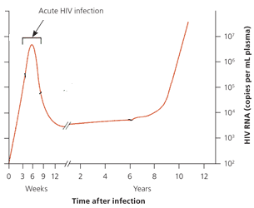
Testing for Acute HIV Infection
Acute HIV:
Occurs 2-4 weeks after initial exposure
Time of highest viral load (up to 3000x more virus than any other stage of HIV)
New infections transmitted by acutely infection range from 10% to 50% of all new infections
Increasing efforts are being made to diagnose acute HIV infection and initiate antiretroviral therapy
Antibody testing does not detect acute infection
Other testing technology (HIV RNA viral load tests or p24 antigen tests) must be used
Staff should also screen for signs of acute HIV infection including rash, fever, chills, headache or fatigue 2-4 weeks after high risk behavior
U.S. Centers for Disease Control and Prevention, HIV Basics – HIV Testing, 2018, https://www.cdc.gov/hiv/basics/testing.html
Ngangue P et al., Returning for HIV Test Results: A Systematic Review of Barriers and Facilitators, Int Sch Res Notices 2016;2016:630
Notes:
Audio
Let’s explore the importance of the fourth-generation HIV tests, which detect both HIV antibodies and antigens to p24, as they are useful to detect HIV infection during the acute stage.
Acute HIV infection occurs most often at about 2-4 weeks after initial exposure to the virus. People who become infected with HIV typically experience their highest viral load during acute infection, when the virus can reach up to 3000 times the concentration in comparison to any other stage in the infection. Estimates of the proportion of new infections resulting from transmission by acutely infected individuals vary considerably depending on the epidemiological setting, ranging from 10% to 50%. While HIV testing has traditionally focused on identifying cases of latent HIV infection, public health officials in many countries are increasingly emphasizing efforts to diagnose acute HIV infection and to initiate antiretroviral therapy during acute infection. HIV antibody testing often does not detect acute infection, which means that other testing technologies, such as HIV RNA viral load tests or p24 antigen tests must be used. HIV testing staff should screen for possible signs of acute HIV infection, such as rash, fever, chills, headache or fatigue occurring within 2-4 weeks after a high-risk behavior.

Slide 12
Testing Challenges Vary Worldwide
The testing challenges that you confront may depend on where you live
Among different parts of the world, the proportion of PLWH who know their HIV status varies considerably
In high-prevalence countries (East and Southern Africa) diagnosis rates are above the global average
In the Middle East and North, West and Central Africa, only about half of all people living with HIV know their HIV status
Notes:
Audio
Although the improvements in HIV testing technologies have made it easier than ever for people to be tested, there are still challenges to getting people tested and meeting the 90-90-90 goals. The testing challenges that you [confront as a clinician] may depend on where you live. Among different parts of the world, the proportion of people living with HIV who know their HIV status varies considerably. In high-prevalence countries in east and southern Africa, diagnosis rates are above the global average. But in the Middle East and North, West and Central Africa, only about half of all people living with HIV know their HIV status.
Developer’s Notes
Sync appearance of on-screen text with audio
Graphics
https://www.istockphoto.com/ca/vector/map-world-seperate-countries-turquoise-gm901315534-248659807
References
Miles to go: closing gaps, breaking barriers, righting injustices, 2015, Geneva: Joint United Nations Program on HIV/AIDS (UNAIDS).
UNAIDS AIDSInfo database, 2018, http://aidsinfo.unaids.org.
Scarbinsky J et al., Human Immunodeficiency Virus Transmission at Each Step of the Care Continuum in the United States, JAMA Intern Med 2015;175:588-596.

Slide 13
Stigma is a Barrier to HIV Testing
Health workers may:
Fear acquiring HIV
Have negative attitudes about PLWH or the groups most at risk of HIV
The result is discrimination, for example:
Taking extra precautions that are not warranted by HIV
Displaying negative or judgmental attitudes that make PLWH feel unwelcome
Refusing to work alongside a colleague who is living with HIV
Denying care to people living with HIV
PLWH may avoid HIV testing and other health services altogether
Your efforts as a clinician to minimize the negative effects of stigma will need to consider not only your own attitudes and behaviors, but the feelings of your clients as well.
Rueda et al., Examining the associations between HIV-related stigma and health outcomes in people living with HIV/AIDS: a series of meta-analyses, BMH Open 2016;6(7):e011453.
Notes:
Audio
Stigma interacts with HIV in many ways. Health workers themselves may fear acquiring HIV and may have negative attitudes about people living with HIV or the groups most at risk of HIV. These stigmatizing attitudes can result in different forms of discrimination, such as taking extra precautions that are not warranted by HIV, displaying negative or judgmental attitudes that make people living with HIV feel unwelcome, refusing to work alongside a colleague who is living with HIV, or, in the most extreme cases, denying care to people living with HIV.
When people living with HIV or at high risk of infection have experienced discrimination in their prior interactions with health workers, they may avoid HIV testing and other health services altogether.
So far we have discussed external stigma – how the perceptions and attitudes of others influence the feelings, well-being and behaviors of people who are stigmatized. But stigma can also be internalized. People who are marginalized may have negative beliefs about themselves, which the stigmatizing attitudes of others only reinforce. Therefore, your efforts as a clinician to minimize the negative effects of stigma will need to take into account not only your own attitudes and behaviors, but the feelings of your clients as well.
In addition to the possibility that individual clinicians may have stigmatizing attitudes, the facilities or institutions where you work may also exhibit stigma. For example, a clinic policy that prohibits services for people who use drugs or who have a history of drug use effectively tells people with substance use disorders that they are unwelcome. And, needless to say, it can also cause real harm to these individuals by limiting their access to health services.

Slide 14
Barriers to Linkage to Care
Provider-based
Example: No systems in place to follow up for missed appointments
May not have functioning linkages in place with community testing programs
Marginalized clients may avoid seeking services from a clinic that has a poor reputation for caring for people like them
Systemic
Availability and accessibility based
A person in a remote area who has to travel to get HIV treatment
Failure to implement a treat-all approach can lead to:
Uncertainty and confusion about when to start treatment
PLWH to fall out of care for extended periods
Linkage
Barriers
Systemic
Client-based
Provider-based
Client-based
Fear and/or internalized stigma
A person who is not fully educated or counseled following a positive HIV test may not understand the importance of immediately seeking HIV treatment services
Setting
Acceptability of provider
Confidentiality
Tso LS et al., Facilitators and Barriers to Linkage to Care Interventions: A Qualitative Evidence Review, AIDS 2017;30(1):1639-1653.
Notes:
Audio
Now that we’ve looked at challenges and barriers to HIV testing, let’s look at barriers to linking patients who have been diagnosed with HIV to care.
There are three categories of barriers that get in the way of swiftly linking people who test HIV-positive to care: systemic, provider-based and client-based.
Click on each category of barrier to learn more.
Launch after learner clicks on each category.
The first set of barriers is systemic, meaning availability and accessibility based. For example, a person who tests HIV-positive in a remote area may have to travel a long way to obtain HIV treatment. Some of you who are completing this module may work in countries that have yet to adopt and fully implement the treat-all approach, which can create uncertainty and confusion about when to begin HIV treatment. Failing to implement the treat-all approach can also lead some people living with HIV to fall out of the care system for extended periods.
Another set of linkage barriers has to do with providers. For example, a clinic may make a medical appointment with someone who has just tested HIV-positive, but have no systems in place to follow up if that person fails to keep the appointment. Clinics may not have functioning linkages in place with community testing programs, which can prevent effective linkage to care. And marginalized clients who have been diagnosed with HIV may avoid seeking services from a clinic that has a poor reputation for caring for people like them.
Finally, there are client-based barriers such as fear and/or internalized stigma, which can create a disincentive for people who have tested HIV-positive to seek medical services. Moreover, a person who is not fully educated or counseled following a positive HIV test may not understand the importance of immediately seeking HIV treatment services. Other client-based barriers may relate to the setting, acceptability of provider, confidentiality and trust.

Slide 15
Innovative HIV Testing Technologies
Section 2
Notes:
Audio
Let’s go over some innovative HIV testing technologies that can address barriers to HIV testing and that will help achieve the first 90-90-90 target of ensuring 90% of all people living with HIV know their status.
Developer’s Notes
Graphics
References

Slide 16
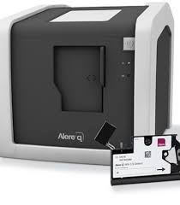
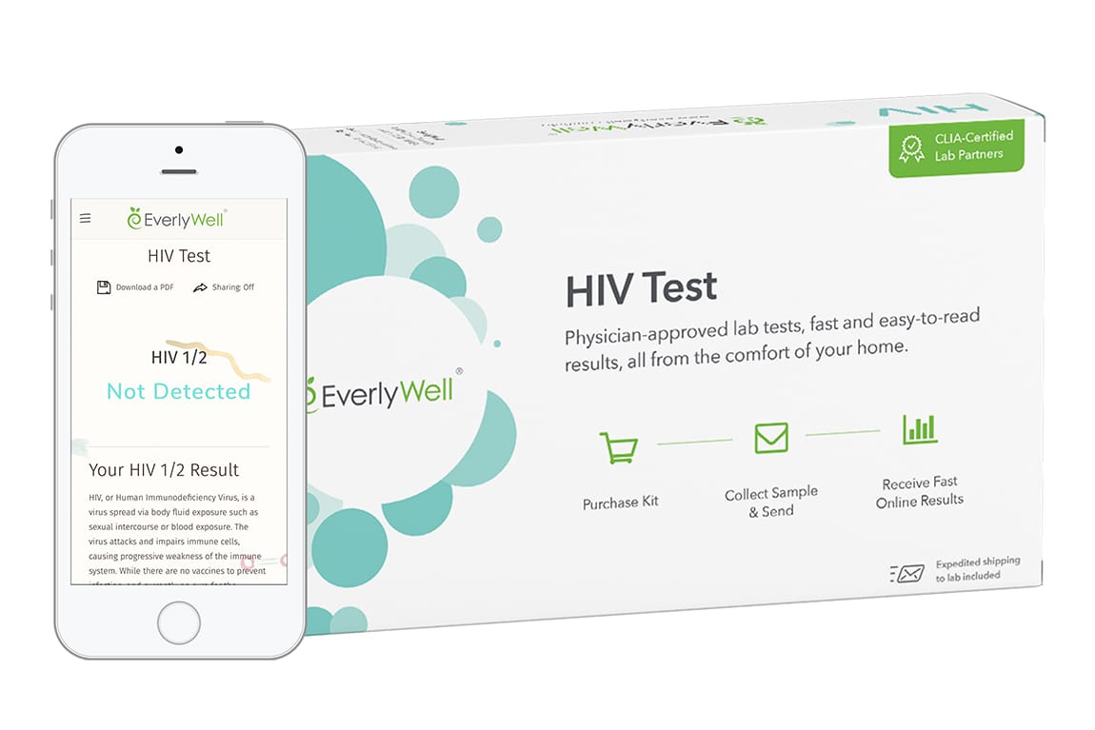
Innovative HIV Testing Technologies
Testing tools that have been in use:
Rapid antibody test
Fourth-generation test
PCR viral load testing for HIV-exposed infants
Click on each type of test to learn more.
HIV Self-Testing (HIVST)
for Adults and Adolescents
Point-of-Care Testing
for Early Infant Diagnosis (POC EID)
Notes:
Audio
The HIV testing tools that have been in use – including rapid antibody testing, fourth-generation tests, and PCR viral load testing for HIV-exposed infants – will remain critical to HIV testing efforts. This section will focus on two additional testing technologies that you may already have heard of. These two technologies have great potential to increase timely knowledge of HIV status. These are HIV self-testing, or HIVST, for adults and adolescents, and point-of-care testing for early infant diagnosis. Click on each type of test to learn more.

Slide 17
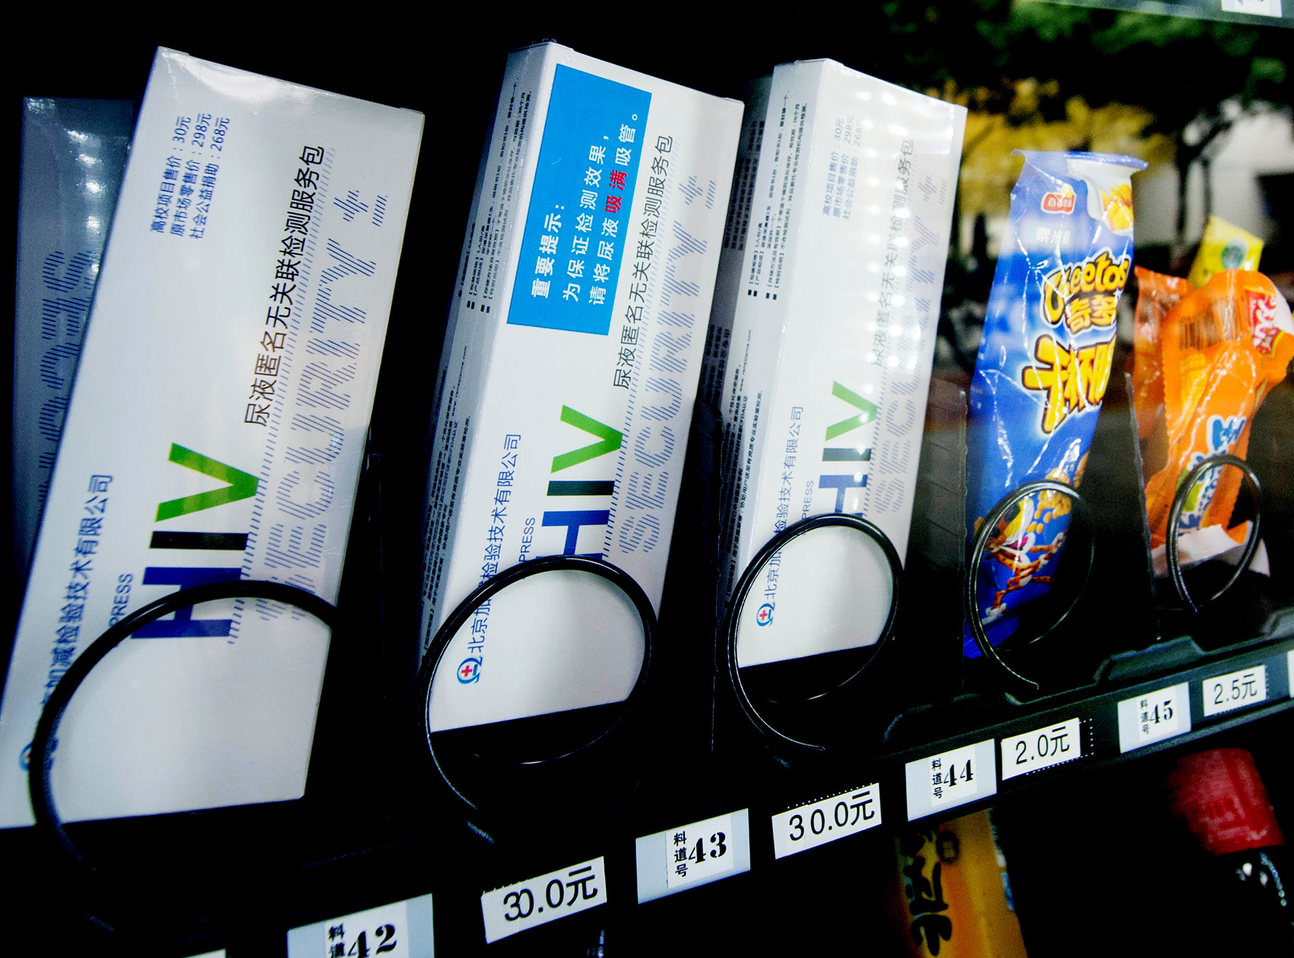
Marketing and Delivery of HIVST
Cities in Focus: Brighton (UK)
Health authorities worked with the LGBT community to design a digital vending machine
Makes accessing HIV self-testing as simple as possible
Placement of a vending machine in a gay sauna resulted in an eight-fold increase in uptake of HIVST compared to community outreach efforts
Pollard A et al., Evaluation of targeted HIV self-test kit distribution via a digital vending machine, Conference on Retroviruses and Opportunistic Infections, Boston, 2018.
Notes:
Audio
HIV self-testing is a novel approach to HIV testing, and it may require novel approaches for marketing and delivery. In the United Kingdom, for example, health authorities worked with the LGBT community to design a digital vending machine to make accessing HIV self-testing as simple as possible. In the Fast-Track City of Brighton, placement of a vending machine in a gay sauna resulted in an eight-fold increase in uptake of HIV self-testing compared to community outreach efforts.

Slide 18
Innovative Testing service delivery strategies
Section 3
Notes:
Audio
As we’ve reviewed, you and your fellow clinicians have a broad array of tools for diagnosing HIV – HIV antibody tests, fourth generation tests for diagnosing acute HIV infection, HIV self-testing, traditional early infant diagnosis using centralized laboratories, and point-of-care early infant diagnosis. But how do you and your clinic best use these diagnostic tools to increase the number of people being tested? Let’s explore this now.

Slide 19
Evidence-based Interventions for HIV Testing
1. Multi-Disease Testing
2. Mobile Testing
3. Home-Based Testing
4. Opt-Out Testing
5. Partner Notification
Notes:
Audio
This section will explore five different strategies that have been identified as effective at increasing the uptake in testing: multi-disease testing; mobile testing; home-based testing; opt-out testing; and partner notification.

Slide 20
1. Multi-Disease Testing
Situate HIV testing in the context of screening for other health problems
Screen for HIV alongside screening for:
Hypertension, diabetes, malaria, cervical cancer, tuberculosis, need for family planning
Potentially reduces the stigma associated with learning one’s HIV status
Chamie G et al., editors. 94% Population HIV Testing Coverage with Repeat Hybrid Mobile Testing in East Africa (# 979). Conference on Retroviruses and Opportunistic Infections; 2016; Boston, USA.
Notes:
Audio
The first innovative strategy to increase the uptake in HIV testing is to situate HIV testing in the context of screening for other health problems. This means screening for HIV alongside screening for hypertension, diabetes, malaria, cervical cancer, tuberculosis, need for family planning potentially reduces the stigma associated with learning one’s HIV status.

Slide 21
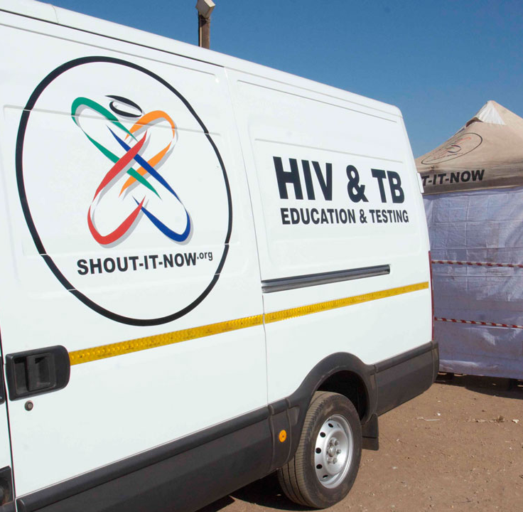
2. Mobile Testing
Take HIV testing on the road
Generates high levels of knowledge of HIV status
Proven to be especially useful for populations not well served by mainstream health facilities
Most effective when services are carefully targeted to locations frequented by people at high risk of HIV infection
Lipsitz MC et al., Bringing testing to the people – benefits of mobile unit HIV/syphilis testing in Lima, Peru, 2007-2009, Int J STD AIDS 2014;25(5):325-331.
Notes:
Audio
Another way to make HIV testing easier for people to access is to literally take HIV testing programs on the road. Studies have shown that mobile HIV testing generates high levels of knowledge of HIV status, including among people who have never tested for HIV. Mobile testing programs have proven to be especially useful for populations that are not well served by mainstream health facilities, such as marginalized populations and residents of informal settlements. As with other testing strategies, mobile testing is most effective when services are carefully targeted to locations frequented by people at high risk of HIV infection.

Slide 22
2. Mobile Testing
Cities in Focus: Paris
Community outreach supported by a citywide communications campaign
Provision of rapid HIV testing in neighborhoods has helped double the number of people tested
Miles to go, 2018, Geneva: Joint United Nations Program on HIV/AIDS.
Notes:
Audio
In the Fast-Track City of Paris, HIV testing in neighborhoods is coupled with community outreach and a broad citywide communications campaign. This combination approach is part of the city’s Fast-Track agenda. The provision of rapid HIV testing in neighborhoods has helped double the number of people tested.

Slide 23
3. Home-Based HIV Testing
Highly effective in achieving high levels of knowledge of HIV status
Trained lay workers go door to door in a community, offering rapid HIV testing to all household members
Especially effective in reaching children and people who have never tested
Evidence is mixed on the success of home-based testing in reaching men and adolescents
Notes:
Audio
Another strategy to increase testing uptake is to consider a campaign of home-based testing, especially if you are working in an area with high prevalence of HIV. Home-based HIV testing has proven highly effective in achieving high levels of knowledge of HIV status. With home-based testing, trained lay workers go door to door in a community, offering rapid HIV testing to all household members.
Home-based testing is especially effective in reaching children and people who have never tested. The evidence is mixed on the success of home-based testing in reaching men and adolescents. For example, as men typically work outside the home, they are likely to be missed by many door-to-door testing initiatives.

Slide 24
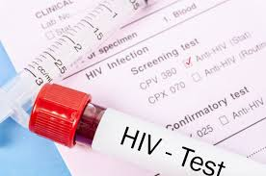
4. Opt-Out HIV Testing
HIV testing is easier when your clinic has made offering the test a routine part of health care delivery
Routine offer can help diagnose HIV in individuals who are ill but unaware of their HIV infection
IAPAC recommends the offer of HIV testing to all patients that present in health care settings
New York State Department of Health, How New York State’s New HIV Testing Law Affects Consumers, 2010, https://www.health.ny.gov/diseases/aids/providers/testing/law/q_and_a_for_consumers.htm.
Notes:
Audio
Let’s look at another strategy to increase HIV testing uptake now. As a provider, you may offer HIV testing to your patients. It’s easier when your clinic has made this a routine part of health care delivery. HIV infection can cause a wide variety of signs and symptoms for which individuals may seek care in health settings. The routine offer of an HIV test in health settings can help diagnose HIV in individuals who are ill but who are unaware of their HIV infection.
IAPAC recommends the offer of HIV testing to all patients that present in health care settings.
HIV testing can occur in a health care setting in several ways. Health providers can entirely leave it up to the patient to ask, without making a recommendation. Alternatively, health providers can recommend testing but leave it to the patient to specifically request testing. That’s what is known as “opt-in.” The third option is known as “opt-out” testing. Here, you as a provider inform your patient that an HIV test will be performed unless they expressly ask not to be tested. Studies have found that opt-out testing generates higher testing rates than patient choice or opt-in testing.
In thinking about which of these three approaches you might want to implement, you will want to find out what your national HIV testing law or policy says. Earlier approaches to HIV testing made it somewhat difficult to test – by requiring extensive pre- and post-test counseling, and by demanding written consent before an HIV test could be performed. Vestiges of this approach may persist in some national laws. In many jurisdictions, HIV testing laws have been revised in order to streamline the testing process and increase HIV testing in health care settings.

Slide 25
5. Partner Notification (Index Testing)
Transmission involves one infected and one uninfected person
Makes sense to notify the partner(s) of the index case that they should be tested
WHO and IAPAC recommend the offer of HIV testing to the partners of all newly diagnosed individuals
Integrate partner notification strategies into HIV testing and treatment programs
Farquhar C et al., Male partner home testing vs clinic invitation in pregnancy: a randomized trial, Conference on Retroviruses and Opportunistic Infections, 2016, Boston, Abstract 49.
Notes:
Audio
The final innovative testing strategy that we’ll explore to increase HIV testing uptake is partner notification. Sexual transmission of HIV, of course, is not a solo event. It requires two people – one of them living with HIV, and the other uninfected – for transmission to occur. Therefore, when you or your colleagues diagnose a new case of HIV infection, it makes sense to notify the partner or partners of the index case that they should be tested for HIV as well. This is called partner notification, or index testing.
WHO and IAPAC recommend the offer of HIV testing to the partners of all newly diagnosed individuals. This requires the integration of partner notification strategies into HIV testing and treatment programs.
There are several possible approaches you can take to partner notification. Partner notification can focus solely on the sexual and drug-using partners named by individuals who test HIV-positive. In high-prevalence settings, index testing involves the routine offer of HIV testing to all members of the household of a person who has tested HIV-positive. In assisted partner notification, trained health workers contact partners or household members to provide counseling and testing. For passive partner notification, health workers advise an individual who has tested HIV-positive to inform her or his sexual or drug-using partners. Contract notification involves an agreement between the health provider and the person who has tested HIV-positive that the client will inform her or his partners. In contract notification, the client receives training on how to disclose her or his HIV status.

Slide 26
EVIDENCE-based interventions for linkage to Care
Section 4
Notes:
Audio
Now that we’ve explored ways to increase HIV testing uptake, let’s review evidence-based interventions to increase linking people living with HIV to care.

Slide 27
Evidence-based Interventions for Linkage to Care
1. Fast-track Treatment Initiation
2. HIV Checkpoints
3. Peer Navigation
4. Decentralization and Community Health Workers
5. Data to Care
Notes:
Audio
Strategies that have been found to be effective at linking people who test HIV positive to care include fast-track, or same-day initiation of antiretroviral therapy, the use of HIV checkpoints, peer navigation, service decentralization and deployment of community health workers, and the use of HIV surveillance, called data to care, to engage clients who are HIV-positive but not in care. Click on each intervention to learn more.

Slide 28
1. Fast-track Treatment Initiation
Same-day initiation of ART for patients who are ready for treatment
Aligned with “treat-all” approach
Found to be feasible in diverse settings
People who receive same-day treatment more likely to be linked to care, more likely to remain engaged in care, and more likely to be virally suppressed
Same-day treatment must always be voluntary – individuals not ready should receive counseling, education and support
Pilcher CD et al., The Effect of Same-Day Observed Initiation of Antiretroviral Therapy on HIV Viral Load and Treatment Outcomes in a US Public Health Settings, J Acquir Immune Defic Syndr 2017;74:44-51.
Notes:
Audio
The first strategy to effectively link people who test HIV-positive is to fast-track treatment initiation. In 2017, the World Health Organization recommended the initiation of antiretroviral therapy on the same day a person tests HIV-positive, in cases where the individual is ready to begin treatment. This represents a shift in the traditional approach to HIV treatment initiation, which delayed treatment initiation for newly diagnosed individuals with high CD4 counts. Same-day treatment initiation is aligned with the WHO’s recommended treat-all approach, which recognizes the benefits of early HIV treatment for the health of people living with HIV.
Numerous studies have assessed the feasibility and health impact of same-day treatment initiation for people testing HIV-positive. There is growing interest in same-day treatment initiation protocols, and studies have proven that this approach is feasible in both resource-rich and resource-limited settings and in both cities and rural areas. For example, in Uganda, same-day initiation has been integrated as policy in at least 20 different HIV clinics. These studies indicate that, compared with people who wait to start HIV treatment, people who initiate antiretroviral therapy on the same day they are diagnosed are more likely to be linked to care, more likely to remain engaged in care, and more likely to be virally suppressed. This has recently been confirmed by a major study undertaken in Port au Prince.
Approaches that have been tried differ. There is growing interest in same-day treatment initiation protocols, and studies have proven that this approach is feasible in both resource-rich and resource-limited settings and in both cities and rural areas.
Same-day treatment initiation must in all cases be voluntary. Individuals who are not ready to begin HIV treatment should not be pressured to do so but instead should receive counseling, education and support.

Slide 29
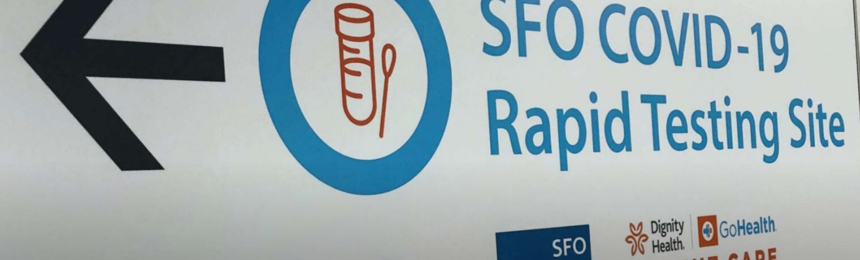
1. Fast-track Treatment Initiation
Cities in Focus: San Francisco
RAPID protocol – links people who test HIV-positive to care within 5 days of diagnosis
HIV providers and patient navigators were trained on RAPID protocol
From 2013-2016, impact:
Time from diagnosis to care - reduced by 38%
Time from diagnosis to treatment initiation – reduced by 96%
Time from diagnosis to viral suppression- reduced by 54%
San Francisco’s
RAPID Program
Bacon O et al., The Rapid ART Program Initiative for HIV Diagnoses (RAPID) in San Francisco, Conference on Retroviruses and Opportunistic Infections, Boston, 2018
Notes:
Audio
In 2013, San Francisco implemented the RAPID protocol, which aims to link all people who test HIV-positive to HIV care within five days of diagnosis. Within the RAPID protocol, HIV treatment is initiated at the first clinic visit. All HIV providers and patient navigators in San Francisco were trained on the RAPID protocol. In the three years following its initiation, the RAPID approach has reduced time from diagnosis to care by 38%, the time from diagnosis to initiation of HIV treatment by 96%, and the time from diagnosis to viral suppression by 54%. You can learn more about the requirements for implementation of the RAPID approach by clicking here.

Slide 30
2. HIV Checkpoints
Used for testing, but serve as a key function in swiftly linking clients to treatment, care and prevention services
If serving a large population of MSM, have a center that offers comprehensive sexual health services
Combines HIV and STI screening
Makes immediate linkage to services, as needed (HIV treatment or PrEP)
Nwokolo N et al., Not just PrEP: other reasons for London’s HIV decline, Lancet HIV 2017;4(4):PE153.
Notes:
Audio
Another evidence-based strategy to increase linkage to care is the use of HIV checkpoints. HIV checkpoints are rapid HIV testing facilities that people can drop into to get tested for HIV. Although HIV checkpoints are a means of delivering rapid HIV testing, often alongside STI screening, they serve a key function in swiftly linking clients to HIV treatment, care, and prevention services.
If you are serving or need to serve a large population of men who have sex with men, one innovative approach is to have a center that offers comprehensive sexual health services. This approach combines HIV and STI screening and makes immediate linkage to services, as needed – to HIV treatment for men who test HIV-positive, and to PrEP for men who test HIV-negative but who engage in risky sexual behavior.

Slide 31
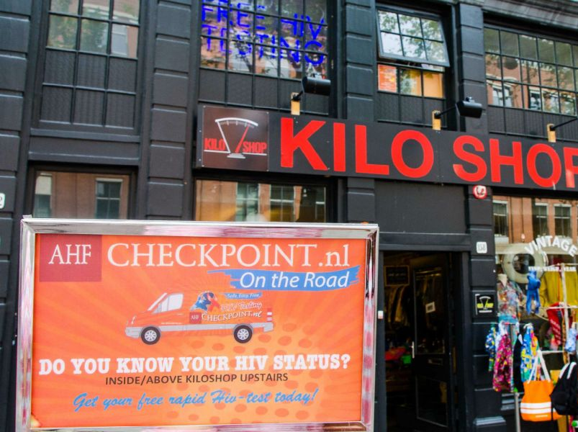
2. HIV Checkpoints
Cities in Focus: Amsterdam
Used rapid tests when public clinics used older HIV antibody tests
Cities in Focus: Melbourne
PRONTO! led by community peers
Cities in Focus: London
Testing done and results provided
by text within hours
Cities in Focus: New York
Underused STI clinics become
comprehensive sexual health clinics
Notes:
Audio
The checkpoint approach is now in use in many cities. One of the first HIV checkpoints was in Amsterdam; this program used rapid testing at a time when public clinics were still using the older HIV antibody tests that required clients to wait for their test results.
Some HIV checkpoints are operated by public health agencies, while others, such as the PRONTO! program in Melbourne, are entirely led by community peers.
Multiple models for these comprehensive sexual health clinics have emerged. In the Fast-Track City of London, the Dean Street Express Clinic is the largest STI clinic in England. It has been configured to provide a comfortable drop-in facility where clients enter sexual risk information in kiosks and use private rooms to collect their oral, rectal and genital specimens. These specimens then are tested, and results are provided to the client by text message within hours.
In the Fast-Track City of New York, the city’s underused STI clinics have been repurposed as comprehensive sexual health clinics. Clients receive rapid HIV and STI testing. Those who test HIV-positive are immediately linked to HIV treatment, and those testing negative are linked to PrEP services, where appropriate.

Slide 32
3. Peer Navigation
Peer navigator
PLWH who provides assistance and support to other PLWH who are newly diagnosed or re-engaging in care
Understands the challenges of a new HIV diagnosis
Recognize the difficulties associated with navigating an often-fragmented and complex service systems
Found to promote:
Retention, treatment adherence, achieving and maintaining viral suppression
US CDC has officially designated a navigation intervention (Project CONNECT) as “evidence-informed intervention” for linkage to care
U.S. Centers for Disease Control and Prevention, Complete Listing of LRC Best Practices, https://www.cdc.gov/hiv/research/interventionresearch/compendium/lrc/completelist.html.
Notes:
Audio
A peer navigator is person living with HIV who provides assistance and support to other HIV-positive people who are newly diagnosed or re-engaging with community services. People living with HIV are ideal peer navigators, as they understand the challenges of a new HIV diagnosis and recognize the difficulties associated with navigating an often-fragmented and complex service systems.
It is a valuable intervention – not only for linking newly diagnosed individuals to care, but also for re-engaging clients who have fallen out of care. It promotes retention in care, aiding in treatment adherence, and achieving and maintaining viral suppression.
The United States Centers for Disease Control and Prevention has identified a navigation intervention – Project CONNECT – as an evidence-informed intervention for linkage to care. Studies have demonstrated that navigation can be especially useful for marginalized groups with special challenges, such as individuals who are released from correctional facilities and who often struggle in obtaining appropriate care in the community.
There is no single model for navigation programs. For newly diagnosed, a usual approach to peer navigation is for the trained navigator to build rapport with the client – either on the day the client tests HIV-positive or within a set period time (such as five days). At this initial meeting, the trained navigator undertakes a psychosocial evaluation of the client and facilitates an initial laboratory assessment. As needed, the navigator is able to link the client with other health services, such as services for substance use and mental health disorders.

Slide 33
4. Decentralization and Community Health Workers
Decentralization brings HIV services to the community, closer to the people who need them
Trained community health workers enhance testing uptake and linkage to care
Shifting tasks will free up your time to provide clinical services
Community health workers come from the communities they serve – builds trust, same language
Community health workers should be:
Trained, provided with required equipment, supervised, provided with opportunities for professional development and advancement, paid a reasonable salary, fully integrated into clinical care teams
Ending AIDS: Progress towards the 90-90-90 targets, Geneva: Joint United Nations Program on HIV/AIDS.
Notes:
Audio
Another strategy to increase and improve linkage to HIV care is decentralization and community health workers.
Linkage to HIV care is easiest when services have been decentralized from health care facilities to community settings. This makes services more convenient to access, bringing them closer to the people who need them. When an individual tests HIV-positive in a community setting, it is easier to access HIV treatment services when they are located in one’s own community rather than having to travel to a health facility that may be crowded and inconvenient.
Trained community health workers have a key role to play in decentralizing services. By shifting tasks that may have previously been performed by physicians and nurses to trained community health workers, you can reach more clients and enhance testing uptake and linkage to care. The availability of community health workers allows you and your fellow clinicians to focus more of your time on the clinical services for which you’ve been specially trained.
Community health workers are most effective when they come from the communities they serve. This builds trust and enables each client’s link to the health system to engage with them in a language and manner they can understand.
Although community health workers are much less expensive to train and compensate than doctors and nurses, there are up-front costs associated with a program of community health workers. These workers must be trained, and they need to be provided with the equipment needed to do their jobs, such as medicines, diagnostics and communications tools. They need to be supervised and provided with opportunities for professional development and advancement. Studies consistently demonstrate that community health workers must be paid a reasonable salary. And these studies also show that community health workers are most effective when they are integrated into the health care system and clinical care teams.

Slide 34
5. Data to Care
Using a well-developed HIV surveillance system to:
Engage clients who are diagnosed HIV-positive but not in care
Re-engage clients who were once in care but who have fallen out
Need to collect reports on all positive HIV, CD4, viral load tests
CDC has developed the “Data to Care” approach
Used in more than 20 states and localities
Data are regularly analyzed to identify those with a positive HIV test and no CD4 or viral load test in a given time period
Identifying someone triggers one of several actions:
The health department contacts the patient’s provider
Public health workers make contact with the individual
Public health authorities work through a community-based organization or network of PLWH
Data to Care: Using HIV Surveillance Data to Support the HIV Care Continuum, Atlanta: U.S. Centers for Disease Control and Prevention, https://effectiveinterventions.cdc.gov/docs/default-source/data-to-care-d2c/pdf-of-important-considerations.pdf?sfvrsn=0.
Notes:
Audio
The final strategy to link people who test HIV-positive to care is to use your well-developed HIV surveillance system, called data to care, to engage clients who are diagnosed HIV-positive but not in care. You can also use this data to re-engage clients who were once in care but who have subsequently discontinued HIV care. To use a data to care approach, your surveillance system will need to collect reports on all positive HIV tests, CD4 tests, and viral load tests.
The United States Centers for Disease Control and Prevention has developed the Data to Care approach, which is now being used in more than 20 states and localities. Surveillance data are regularly analyzed to identify individuals with a positive HIV test result who have no evidence of a CD4 or viral load test in a given time period.
Identifying an HIV-diagnosed person who is out of care triggers one of several actions. In some jurisdictions, the health department contacts the patient’s provider, who is responsible for re-engaging the individual. In others, public health workers make contact with the individual and work to re-link the patient to care. Another approach is for public health authorities to work through a community-based organization or network of people living with HIV to re-engage the individual who is not in care.

Slide 35
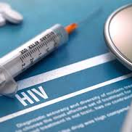
5. Data to Care
Cities in Focus: New York City
75% of individuals who were out of care have been re-linked to HIV care
Re-linked clients have become consistent users of HIV health services and achieved high levels of viral suppression
Data to Care
Hart-Malloy R, Tesoriero J, Data to Care: A Critical Tool for Ending AIDS in New York State, 2016,
https://www.hiv.gov/blog/data-to-care-a-critical-tool-for-ending-aids-in-new-york-state.
Notes:
Audio
There is evidence that this approach works. In New York City and a limited set of additional parts of New York State, 75% of individuals re-engaged through Data to Care were effectively linked back into HIV care. Early evidence suggests that those who were re-linked to care have become consistent users of HIV health services and achieved high levels of viral suppression. For more information on Data to Care, click here.

Slide 36
Summary
Section 1:
The Importance and Challenges of Early HIV Diagnosis and Linkage to Care
Section 2:
Innovative HIV Testing Technologies
Section 3:
Innovative Testing Service Delivery Strategies
Section 4:
Evidence-based Interventions for Linkage to Care
Notes:
Audio
This brings us to the end of the module, so let’s summarize the key concepts you explored.
In Section 1, you reviewed the importance of early HIV diagnosis and linkage to care, and the challenges and barriers that get in the way.
In Section 2, you explored innovative HIV testing technologies, specifically HIV self-testing for adults and adolescents, and point-of-care testing for early infant diagnosis.
In Section 3, you took a close look at five innovative service delivery strategies to increase the uptake in HIV testing. These are multi-disease testing; mobile testing; home-based testing; opt-out testing; and partner notification.
Section 4 went over evidence-based interventions to ensure that people who test HIV-positive are linked to HIV treatment and care in a timely manner. These strategies are fast-track, or same-day initiation of antiretroviral therapy, the use of HIV checkpoints, peer navigation, service decentralization and deployment of community health workers, and the use of HIV surveillance, called data to care, to engage clients who are HIV-positive but not in care.
Thank you for completing this module.

