Slide 1
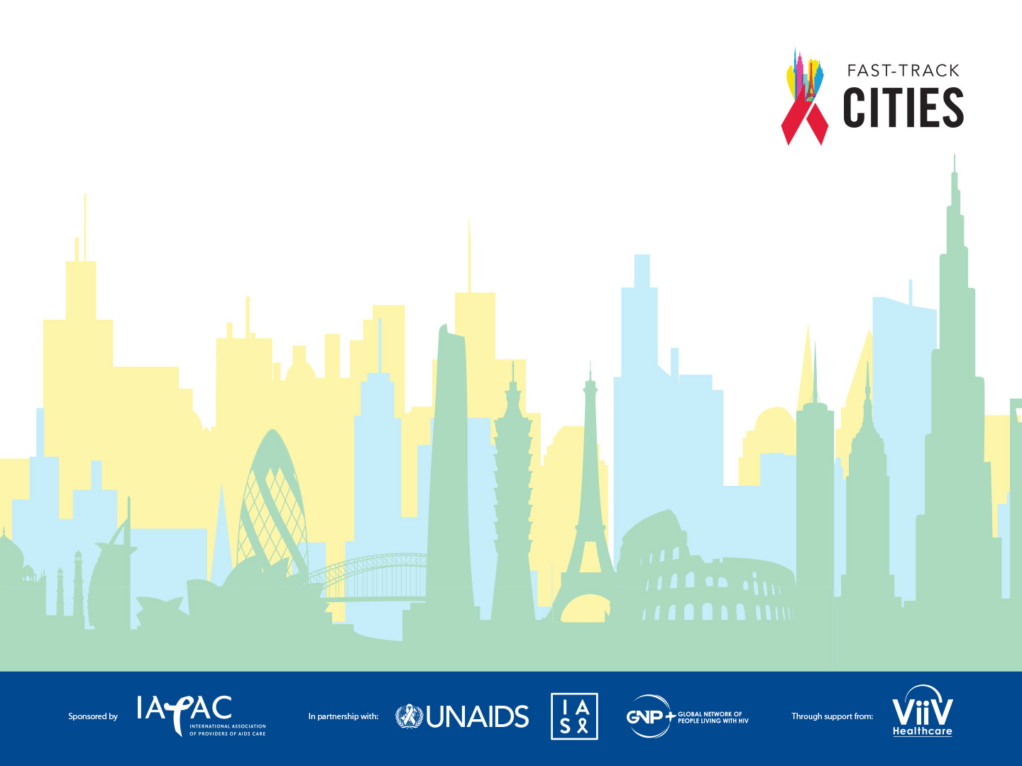
Clinician Capacity Building E-Course
Module 2
Antiretroviral Therapy Initiation

Slide 2
LEARNING OBJECTIVES
The purpose of this module is to inform current recommendations and best practices for the initiation of ART, treatment adherence and retention in care
After completing this module, you will be able to…
Explain the treatment and prevention benefits of ART
Describe existing recommendations and the latest evidence on initiation of ART
Describe how emerging HIV initiation, adherence and retention practices can maximize the proportion of your HIV patients who are virally suppressed
Notes:
The purpose of this module is to inform current recommendations and best practices for the initiation of ART, treatment adherence and retention in care
After completing this module, you will be able to…
Explain the treatment and prevention benefits of ART
Describe existing recommendations and the latest evidence on initiation of ART
Describe how emerging HIV initiation, adherence and retention practices can maximize the proportion of your HIV patients who are virally suppressed

Slide 3
The Health Benefits of Antiretroviral Therapy
ART substantially improves health and well-being for PLHIV
PLHIV can now have a near-normal life span
ART has sharply lowered AIDS-related deaths and disability
More than 6-fold decline in deaths in U.S.
Continuous ART likely to serve as central HIV treatment strategy for some time
Katz IT, et al, Marcus et al, Murray CJL et al. Grinsztejn B et al, Fidler S et al,
HIV in the United States: At a Glance, 2018, Atlanta: U.S. Centers for Disease Control and Prevention
EMPRANO ANRS 12136 Study Group, INSIGHT START Study Group
Notes:
You undoubtedly are familiar with the health benefits of antiretroviral therapy, but it’s worth reminding ourselves of how transformative antiretroviral therapy has been for our efforts to manage HIV infection. Both extensive scientific study and real-world experience have shown that antiretroviral therapy improves the health, well-being and quality of life of people living with HIV. Today, especially as the quality of antiretroviral regimens has improved over time, a person living with HIV can expect to live nearly as long as an uninfected person.
In all places where HIV treatment is widely available, AIDS-related deaths have sharply fallen. In the U.S., AIDS-related deaths dropped more than 6-fold from 1995 to 2015 as a result of antiretroviral therapy.
You have probably heard about the increasing interest in research to generate a functional cure for HIV. Indeed, there is considerable research activity happening toward development of a cure. However, this road is likely to be challenging and potentially long. As reported at the 2018 International AIDS Conference, the first-ever randomized HIV cure study found that the addition of a vaccine-plus-drug regimen did not reduce the number of HIV-infected cells in participants’ bodies. Continuous antiretroviral therapy, in short, is likely to remain the cornerstone of HIV treatment for the foreseeable future.

Slide 4
The Prevention Benefits of Antiretroviral Therapy
Clinical trials have found that ART sharply lowers the risk of HIV transmission
Prevention benefits of ART have been confirmed in the real world (Vancouver, KwaZulu-Natal, PEPFAR studies)
No linked seroconversion in studies of serodiscordant partners (U=U)
Sources: Montaner JS et al., Cohen M et al.. Rodger A et al., Montaner JSG et al., Tanser F et al.,
PHIA (Population-Based HIV Impact Assessment) Project, Data Summaries, https://phia.icap.columbia.edu/resources/.
Notes:
Antiretroviral therapy also protects against HIV transmission. There are numerous prophylactic uses of antiretroviral therapy – for prevention of mother-to-child transmission, as pre-exposure prophylaxis, and as post-exposure prophylaxis for both occupational and non-occupational exposures. Here we are concerned solely with the preventive effects of HIV treatment.
In 2006, a team of leading HIV experts urged the accelerated scale-up of antiretroviral therapy to slow the spread of HIV. They argued that the evidence – from observational studies and from studies on other preventive uses of antiretroviral therapy – was already sufficient to recommend the use of treatment for prevention of transmission. In 2011, a large clinical trial confirmed the wisdom of this recommendation when it found that HIV treatment was associated with a 96% decline in HIV transmission among serodiscordant couples (that is, couples in which one partner is HIV-infected and the other HIV-uninfected).
The prevention benefits found in this clinical trial have been confirmed in the real world. In settings as diverse as Vancouver and the KwaZulu-Natal province of South Africa, increased coverage of antiretroviral therapy has been linked with a decline in new HIV infections. Most recently, a series of surveys by Columbia University experts, for the benefit of the U.S. PEPFAR program, have correlated a decline in new HIV infections with improved results across the HIV treatment cascade in 10 different countries in sub-Saharan Africa.
Most recently, longitudinal studies of serodiscordant partners have found no linked case of HIV transmission where the positive partner is virally suppressed. These findings have given rise to a global movement known as U=U – undetectable equals untransmittable. U=U has already had a powerful effect in reducing the stigma associated with HIV.

Slide 5

Maximizing the Benefits of ART
Initiating ART
Adherence and retention interventions
When to start ART
What to use as first-line therapy
Dolutegravir and pregnancy
Why adherence and retention are important
Peer interventions
mHealth interventions
Patient navigation
Data to care
Clinic practices
Notes:
The rest of this module will explore ways that you can maximize the benefits of antiretroviral therapy for your patients. The next section of the module will focus specifically on initiating antiretroviral therapy, focusing on when to start treatment and what to use as a first-line regimen. This section will also address a new controversy regarding the use of dolutegravir by reproductive-age women.
The final section will focus on best practices and promising approaches to increase treatment adherence and retention in care. Adherence and retention are considered together in this final section, as most of the intervention approaches we’ll discuss are potentially applicable to both objectives, which are closely related. After quickly reviewing why adherence and retention is important, you will explore different strategies for increasing adherence and retention – through the use of peers, the use of mobile communications technology, and patient navigation. You’ll hear about how surveillance data can be useful in helping you re-engage patients who may have discontinued care and about how changes in your clinic operations might improve retention in care.

Slide 6
When to Start ART

Slide 7
When to Start ART
Treatment Guidelines
The Importance of the Earliest Possible Treatment Initiation
Fast-Tracking Treatment Initiation
Notes:
Antiretroviral therapy is now recognized for people at any stage of HIV infection. For those of you have been treating patients with HIV for a number of years, you know that this is a shift from the previous standard of care. Before the HPTN 052 trial results in 2011, clinicians were advised to recommend therapy for their patients living with HIV only when the patient’s CD4 count had fallen below a certain threshold. This threshold changed over time as evidence grew of the clinical benefits of earlier initiation of therapy for people living with HIV. Now, we know that there is no time during HIV infection when treatment is not appropriate.
In this section of the module, we will review the leading sources of clinical recommendations for when to start antiretroviral therapy. You will hear about the growing body of evidence on the importance of the earliest possible initiation of treatment. And we will explore various strategies that are being implemented to ensure that people who test HIV-positive are immediately started on HIV treatment.

Slide 8
Test-and-Treat: Clinical Guidelines
ART is recommended for all individuals with HIV, regardless of CD4 count
  to reduce morbidity and mortality and to prevent new HIV infections
  NIH, European AIDS Clinical Society, IAS-USA. Australasian Society of HV Medicine
Treatment must remain voluntary in all cases
  counseling and support should be given to patients who are not ready to begin ART
Panel on Antiretroviral Guidelines for Adults and Adolescents, Guidelines for the Use of Antiretroviral Agents in Adults and Adolescents Living with HIV, Department of Health and Human Services, 2018, http://aidsinfo.nih.gov/guidelines. Guidelines Version 9.0, 2017, European AIDS Clinical Society.
Saag MS et al., Antiretroviral Drugs for Treatment and Prevention of HIV Infection in Adults: 2018 Recommendations of the International Antiviral Society-USA Panel, JAMA 2018;320:379-396.
Australasian Society for HIV, Viral Hepatitis and Sexual Health Medicine (ASHM) Sub-Committee for Guidance on HIV Management in Australia
Notes:
HIV treatment is now recommended at all stages of HIV infection and as soon after HIV diagnosis as possible. This standard on when to start is recommended by the U.S. National Institutes of Health, the European AIDS Clinical Society, and the USA Panel of the International AIDS Society. All of these guidelines emphasize the immediacy of the need to start HIV treatment once a patient is diagnosed with HIV. For example, treatment may be initiated on the same day a patient tests HIV-positive, although the IAS panel defines “immediate” as occurring within 14 days of diagnosis.
The guidelines recognize that some individuals may not be ready to begin treatment. The European guidelines recommend that clinicians assess the patient’s readiness to start HIV treatment and also ask about the individual’s preferences. In cases where the patient may not be ready to start therapy immediately, the European guidelines recommend that clinicians work with the patient to guide the individual through the process of readiness to start treatment --- from precontemplation, through the stages of contemplation and preparation.
Australian Antiretroviral Guidelines follow US DHHS Guidelines with Australian commentary. Antiretroviral therapy is recommended for all persons with HIV to reduce morbidity and mortality) and to prevent the transmission of HIV to others. The Panel on Antiretroviral Guidelines for Adults and Adolescents recommends initiating ART immediately (or as soon as possible) after HIV diagnosis in order to increase the uptake of ART and linkage to care, decrease the time to viral suppression for individual patients, and improve the rate of virologic suppression among persons with HIV
In addition, the IAS guidelines acknowledge that some clinic settings may not be prepared, in terms of staffing or available services, to immediately initiate HIV treatment for a person who has just been diagnosed. The IAS urges action to address and overcome these structural barriers in order to allow the earliest possible initiation of treatment.

Slide 9
Importance of the Earliest Possible Treatment Initiation
Clinical benefit: educe morbidity and mortality
Prevention benefits: Reducing duration of unsuppressed virus
Melbourne:
  Duration of infectiousness among gay men fell five-fold
    from 49.0 months to 9.6 months
    2007-2016
    Changes in guidelines and recommendations cited
Sources: Grinsztejn B et al.. Medland NA et al., TEMPRANO ANRS 12136 Study Group. INSIGHT START Study Group
Notes:
Narrative:
After the HPTN 052 findings in 2011 on the prevention benefits of antiretroviral therapy, some public health agencies still hesitated to recommend a test-and-treat approach for HIV because of uncertainties about whether early treatment actually benefited people living with HIV. Those questions have now been definitively answered – by subsequent follow-up of the HPTN 052 cohort and by two other large clinical trials, the START and TEMPRANO studies, which demonstrated that people living with HIV who begin treatment at a very early stage of HIV infection – before their CD4 count has fallen below 500 – developed fewer clinical events and had greater health and well-being compared to similar patients who didn’t start therapy until later.
The prevention benefits of the earliest possible initiation of treatment are compelling. By shortening the duration of time when an individual with HIV has unsuppressed virus, early treatment initiation dramatically reduces the opportunities for further HIV transmission. In the Fast-Track City of Melbourne, a change in testing guidelines to recommend repeat testing for gay and bisexual men reduced more than five-fold the average time that an HIV-positive gay man has unsuppressed HIV.

Slide 10
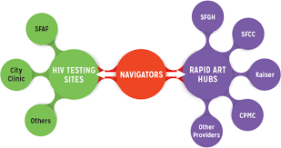
Fast-Track Treatment Initiation
Numerous cities have moved to provide same-day treatment initiation, including
  Melbourne, New York, San Francisco
Same-day treatment initiation is associated
  with reduced loss to follow-up
  increased uptake of antiretroviral therapy
  increased viral suppression
  improved retention in care
Same-day treatment initiation must always be voluntary
Sources: Rosen S et al., Amanyire G et al., Pilcher CD et al., Labhardt ND et al Koenig SP et al. Bacon O et al., Stoové M et al.,
Ending AIDS: Progress towards the 90-90-90 targets, 2018; Geneva: United Nations Program on HIV/AIDS.
Notes:
To translate the guidelines’ recommendation for immediate initiation of treatment, numerous cities, including New York and San Francisco, now offer same-day treatment initiation.
Studies indicate that, compared with people who wait to start HIV treatment, people who initiate antiretroviral therapy on the same day they are diagnosed are more likely to be linked to care, more likely to remain engaged in care, and more likely to be virally suppressed.
Same-day treatment initiation must in all cases be voluntary. Individuals who are not ready to begin HIV treatment should not be pressured to do so but instead should receive counseling, education and support.
San Francisco has implemented the RAPID protocol, which aims to link all people who test HIV-positive to HIV care within five days of diagnosis. HIV treatment is initiated at the first clinic visit. All HIV providers and health navigators in San Francisco were trained on the RAPID protocol. In the three years since its initiation, the RAPID approach has reduced time from diagnosis to care by 38%, the time from diagnosis to initiation of HIV treatment by 96%, and the time from diagnosis to viral suppression by more than 50%. You can learn more about the requirements for implementation of the RAPID approach by clicking on the link in this slide.

Slide 11
Experience in San Francisco and Melbourne
Demonstrates the impact of Fast-Track treatment initiation
Citywide RAPID program
  links new HIV diagnoses to care within 5 days
  treatment initiated at the first visit
From 2013 to 2016
  reductions in time from diagnosis to care
  diagnosis to treatment initiation
  diagnosis to viral suppression
New findings from Melbourne
  HIV incidence declined
  average time between diagnoses and undetectable viral load fell
For information on San Francisco’s RAPID program:
https://www.gettingtozerosf.org/wp-content/uploads/2016/09/20160822_citywide_rapid_protocol_v2.pdf
Notes:
San Francisco has implemented the RAPID protocol, which aims to link all people who test HIV-positive to HIV care within five days of diagnosis. HIV treatment is initiated at the first clinic visit. All HIV providers and health navigators in San Francisco were trained on the RAPID protocol. In the three years since its initiation, the RAPID approach has reduced time from diagnosis to care by 38%, the time from diagnosis to initiation of HIV treatment by 96%, and the time from diagnosis to viral suppression by more than 50%. You can learn more about the requirements for implementation of the RAPID approach by clicking on the link in this slide.
New findings from Melbourne point toward public health benefits of fast-track treatment initiation (HIV incidence declined from 0.86% in 2015 to 0.27% in 2017 as the average time between diagnoses and undetectable viral load fell from 98 days to 49 days from 2014 to 2016)

Slide 12
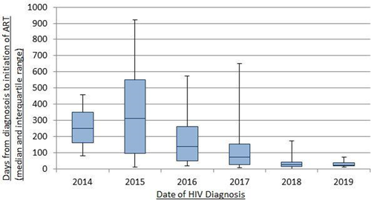
Similar results from Western Europe
Days from diagnosis to initiation of ART
Median & interquartile range
EACS 2019 – Abstract Book Nov 2019

Slide 13
What to Start
3-drug regimens
2-Drug regimens
Dolugetravir, Pregnant Women and Children
Notes:
Antiretroviral therapy is now recognized for people at any stage of HIV infection. For those of you have been treating patients with HIV for a number of years, you know that this is a shift from the previous standard of care. Before the HPTN 052 trial results in 2011, clinicians were advised to recommend therapy for their patients living with HIV only when the patient’s CD4 count had fallen below a certain threshold. This threshold changed over time as evidence grew of the clinical benefits of earlier initiation of therapy for people living with HIV. Now, we know that there is no time during HIV infection when treatment is not appropriate.
In this section of the module, we will review the leading sources of clinical recommendations for when to start antiretroviral therapy. You will hear about the growing body of evidence on the importance of the earliest possible initiation of treatment. And we will explore various strategies that are being implemented to ensure that people who test HIV-positive are immediately started on HIV treatment.

Slide 14
Recommended Initial Regimens for Most People
What to Start
DHHS Australian Antiretroviral Guidelines follow US DHHS Guidelines with Australian commentary | European AIDS Clinical Society | IAS-USA
INSTI plus 2 NRTIs BIC/TAF/FTC DTG/ABC/3TC if HLA-B*5701 negative DTG plus (TAF or TDF)a plus (FTC or 3TC) RAL plus (TAF or TDF)a plus (FTC or 3TC) INSTI plus 1 NRTI DTG/3TC except for individuals with HIV RNA >500,000 copies/mL, HBV coinfection, or in whom ART is to be started before the results of HIV genotypic resistance testing for reverse transcriptase or HBV testing are available/emtricitabine | ABC/3TC + DTG ABC/3TC/DTG (Must be HLA-B*57:01 negative and HBsAg negative) TAF/FTC or TDF/FTC or TDF/3TC + DTG TAF/FTC/BIC TAF/FTC or TDF/FTC or TDF/3TC + RAL qd or bid | Bictegravir/TAF/emtricatabine Dolutegravir/abacavir/lamivudine Dolutegravir plus TAF/emtricitabine
Panel on Antiretroviral Guidelines for Adults and Adolescents, Guidelines for the Use of Antiretroviral Agents in Adults and Adolescents Living with HIV, Department of Health and Human Services, July 2019 , http://aidsinfo.nih.gov/guidelines.
Guidelines Version 10, Nov 2019, European AIDS Clinical Society. https://eacs.sanfordguide.com/art/initial-regimens-arv-naive-adults
Saag MS et al., Antiretroviral Drugs for Treatment and Prevention of HIV Infection in Adults: 2018 Recommendations of the International Antiviral Society-USA Panel, JAMA 2018;320:379-396.
HIV Management in Australasia ASHM https://hivmanagement.ashm.org.au/
Notes:
The DHHS Panel emphasizes the importance of screening and early diagnosis of HIV. In order for persons with HIV to benefit from early diagnosis, the Panel recommends that ART be started immediately or as soon as possible after diagnosis to increase the uptake of ART, decrease the time required to achieve linkage to care and virologic suppression for individual patients, reduce the risk of HIV transmission, and improve the rate of virologic suppression among persons with HIV.
Based on the results of two large, randomized controlled trials that showed that a two-drug regimen of DTG plus lamivudine (DTG/3TC) was noninferior to DTG plus tenofovir disoproxil fumarate (TDF)/emtricitabine (FTC), the Panel has added DTG/3TC to the list of Recommended Initial Regimens for Most People with HIV, except for individuals:
With pre-treatment HIV RNA >500,000 copies/mL;
Who are known to have active hepatitis B virus (HBV) coinfection; or
Who will initiate ART before results of HIV genotype testing for reverse transcriptase or HBV testing are available.

Slide 15
Dolutegravir, Pregnant Women and Children
What to Start
DHHS Australian Antiretroviral Guidelines follow US DHHS Guidelines with Australian commentary | European AIDS Clinical Society | IAS-USA
Providers should discuss the benefits of using DTG and the risk of NTDs with the person of childbearing potential, to allow the person to make informed decisions about care. DTG may be used as an alternative ARV for individuals who are of childbearing potential and trying to conceive and those who are sexually active and not using contraception. For individuals who are using effective contraception, DTG may be used as a recommended option | Higher risk of neural tube defects if used preconception. Should be switched to another drug | All individuals of childbearing age should have documentation of a negative pregnancy test result before starting dolutegravir and should be counseled regarding this potential risk More data are expected it is not yet clear whether other InSTIs pose a similar risk of neural tube defects.
Panel on Antiretroviral Guidelines for Adults and Adolescents, Guidelines for the Use of Antiretroviral Agents in Adults and Adolescents Living with HIV, Department of Health and Human Services, July 2019 , http://aidsinfo.nih.gov/guidelines.
Guidelines Version 10, Nov 2019, European AIDS Clinical Society. https://eacs.sanfordguide.com/art/initial-regimens-arv-naive-adults
Saag MS et al., Antiretroviral Drugs for Treatment and Prevention of HIV Infection in Adults: 2018 Recommendations of the International Antiviral Society-USA Panel, JAMA 2018;320:379-396.
HIV Management in Australasia ASHM https://hivmanagement.ashm.org.au/
Notes:
The latest data on neural tube defects (NTDs) in infants born to women who received dolutegravir (DTG) around the time of conception have shown that the prevalence of NTDs is lower than initially reported (the rate has been reduced from 0.9% to 0.3%). However, this rate is still higher than the rate reported for infants born to individuals who received ART that did not contain DTG (0.1%).
Recommendation statements from the three major guideline providers as summarized in the above slide.

Slide 16
Long-Acting Injectable Cabotegravir and Rilpivirine
CAB and RPV intramuscular (IM) injections e
  used as an optimization strategy
  for people with HIV currently on oral antiretroviral therapy (ART)
  with documented viral suppression for at least 3 months who:
have no baseline resistance to either medication
have no prior virologic failures
do not have active hepatitis B virus (HBV) infection (unless also receiving an oral HBV active regimen)
are not pregnant and are not planning on becoming pregnant
are not receiving medications with significant drug interactions with oral (during lead-in or bridging therapy) or injectable CAB or RPV
Source: HHS Adults and Adolescents Antiretroviral Guidelines Panel Recommendation for the Long-Acting Injectable Antiretroviral Regimen of Cabotegravir and Rilpivirine https://clinicalinfo.hiv.gov/sites/default/files/guidelines/documents/AdultARV_GL_ID_2021_CabRpv.pdf
Notes:
On January 21, 2021, the U.S. Food and Drug Administration (FDA) approved the first complete long-acting injectable antiretroviral (ARV) regimen, cabotegravir (CAB) and rilpivirine (RPV), as an option to replace the current ARV regimen in adults with HIV who are on stable ARV therapy (ART), with HIV RNA levels <50 copes/ml. have no history of treatment failure and have no known or suspected resistance to these agents
CAB is a novel integrase strand transfer inhibitor (INSTI) and structural analogue of dolutegravir. RPV is a non-nucleoside reverse transcriptase inhibitor (NNRTI), which was first approved in an oral tablet formulation in 2011.2 A tablet formulation of CAB was concurrently approved by the FDA to be used with RPV tablets as a 4-week oral lead-in therapy prior to initiation of the long-acting injectable regimen and as oral bridging in the event of pre-planned missed injections.

